Slide 1

Lena Pieper
University of Illinois
Understanding audit firm culture through the lens of the competing values framework

Slide 2





The Project Team
Prof. Murray Barrick
Texas A&M
Prof. Olof Bik
Rijksuniversiteit Groningen
Prof. Jere Francis
Maastricht University
Lena Pieper
University of Illinois Urbana - Champaign
Prof. Ann Vanstraelen
Maastricht University

Slide 3


Agenda
Importance of organizational culture | 1
Pupose of our project | 2
Data Gathering | 3
Overview of resuls | 4
Implications for practice | 5
Contribution | 6

Slide 4
Importance of Organizational Culture
Organizational Culture = set of shared values, beliefs, norms and practices that characterize an organization and guide how employees think and act.
Large body of research documents the importance of organizational culture:
    Drives a sense of alignment between employees and the organization
    Influences individual and organizational performance
    Can benefit the attraction and retention of talents
    …
During the recent decade, there is an increasing focus on organizational culture in the auditing profession → “audit-quality oriented firm culture”
Notes:
Wide variety of organizational culture in general > provide definition and benefits >
Then audit-specific: increasing focus from practitioners and regulators > relate to keynote Martin and panel before > org. culture as a form of internal control, the fundament

Slide 5
Audit Firm Culture
Creating an organizational culture in audit firms (and other professional service firms) can be challenging:
1.
2.
Decentralized Structure
Partnership Model
3.
4.
Different Service-Lines
High Employee Mobility & Turnover
Notes:
1. Decentralized structure > across offices > but even within teams and now also virtual (refer to Iver)
2. Partnership Model > this is not necessarily bad, but just requires a unity in voices if there is more leaders. Different partners might have different interpretations of values, different priorities > in a “traditional corporate setting” > in German, we have a saying “too many chefs”..
3. Varied Service-Lines and Specialization > while we are interested in the audit service line specifically, this service line does not operate in a vacuum. > different service lines might have different priorities, yet they all operate under one corporate identity >
4. High Employee Mobility & Turnover > employees move around; high turnover > sense of consistency might be difficult to achieve.

Slide 6
Research Questions
The overall aim of our project is to advance our understanding of audit firms’ organizational culture:
What type of organizational culture is present in audit firms?
Do audit firms successfully create their desired organizational culture?
Which embedding mechanisms are more (or less) effective in establishing the organizational culture?
Notes:
Introduce the overarching RQs.
Type of org. culture
Given the complexities of the way audit firms are structured, do audit firms effectively create their desired organizational culture?
Which embedding mechanisms are more or less effective in establishing the org. culture?

Slide 7
Competing Values Framework
We rely on a theoretical framework called the “Competing Values Framework” to examine audit firm culture.
This model has been developed to understand, diagnose, and change organizational culture.
Two key dimensions:
  Internal vs. External Focus
  Flexibility vs. Stability
Notes:
Intro to Competing Values Framework
Explain the two dimensions > why were those dimensions chosen ?
Internal Focus: Organizations with an internal focus emphasize the development of their internal processes, cohesion, and smooth functioning. They prioritize internal efficiency, employee engagement, and organizational harmony. These organizations value stability, control, and maintaining the status quo.
External Focus and Differentiation: Organizations with an external focus prioritize their relationship with the external environment, including customers, competitors, and other stakeholders. They emphasize adaptability, market positioning, competitiveness, and growth. These organizations value flexibility, innovation, and responding to external changes.

Slide 8
Overview CVF – 4 C’s
Flexibility
Collaborate
Create
Internal
External
Control
Compete
Stability
Notes:
Now if we plot these two dimensions, this gives raise to a 2x2 matrix.
Prior research > different leadership styles > different ways of establishing such a culture
Collaborate = core values: = > leadership style emphasis > nurturing and mentoring
Create = core values: => leadership style
Control = core values: => leadership style
Compete = core values => leadership style:
Not necessarily one dominant culture > but these can co-exist to different degrees > combination of values gives raise to an idiosyncratic organizational culture
This framework is the backbone of our study and we will apply this framework to the audit firms in our sample.

Slide 9
Data Gathering
Large scale survey with nine participating audit firms (incl. all Big Four firms) and semi-structured interviews with senior leadership of the Big Four firms.
To ensure representativeness and to capture all function levels, we developed our selection procedure as such:
This resulted in 6,279 invitations, and overall we collected 3,195 responses (response rate 51%). Our final sample includes 2,795 responses (65% from the Big Four firms).
Firm
Office/Business Unit
Function Levels
Notes:
Process: select sufficient people from each office & function level > ensure representativeness

Slide 10
Data Sample
Partner
Quick Facts
32% of our respondents are female
Average professional experience is 8.4 years
Average firm tenure 6.7 years.
Notes:
High-Level Overview of our Respondents >. In line with our sampling strategy, we feel like we got a good representative sample of the audit firms’ employees

Slide 11
Results
Flexibility
Collaborate
Create
Internal
External
Control
Compete
Stability
Notes:
Baseline: what is the current culture in the audit firms

Slide 12
Current Audit Firm Culture
Based on the CVF, Collaborate (#1) and Control (#2) are the most dominant C’s in the current audit firm culture.
The control element seems to be in part also driven by regulatory initiatives/oversight activities, as indicated by senior leadership of the audit firms.
Compared to companies in other industries, audit firms are seemingly less focused on one particular dimension.
Notes:
First, we use the CVF to understand the “DESIRED firm culture” > what is important to the firm?
First show desired audit firm culture --> also link this to the interviews with the firms (see Jere’s notes) [Collaborate & Control -> Control seems to also be a focus that is simply part of the auditing profession and something that was indicated to be driven by regulatory initiatives/oversight activities by the AFM → similar sentiment in the US and the view on the PCAOB
Comparison to other firms > not as clear cut of a focus on one specific dimension
And as these C’s are often viewed as being in conflict with one another – extra challenging to impose

Slide 13
Differences Across Firms?
We do observe differences across firms:
    Big Four firms exhibit stronger cultural values, on average.
    Big Four firms score significantly higher on Compete.
    Within the Big Four group, we also observe some nuanced differences – some of which are seemingly in line with the emphasis placed in the firms’ corporate values (as seen on their websites).

Slide 14
Current Audit Firm Culture
Does everyone within the organization share a similar view of the current organizational culture?
Strength of organizational culture

Slide 15
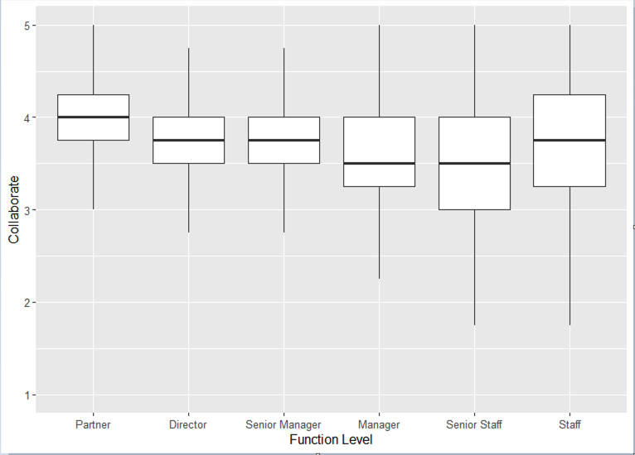
Differences Across Function Levels
1.
Mean is shifting.
2.
Variance is increasing = less agreement.

Slide 16
Culture Gaps?
A key advantage of using the CVF is that it allows us to identify different gaps in the organizational culture by comparing:
Desired Organizational Culture
Current
Organizational Culture
With this data, we answer two more questions helping us understand audit firm culture:
How effective are audit partners in communicating the firm’s desired values?
How effective are audit partners in embedding the firm’s desired values?

Slide 17
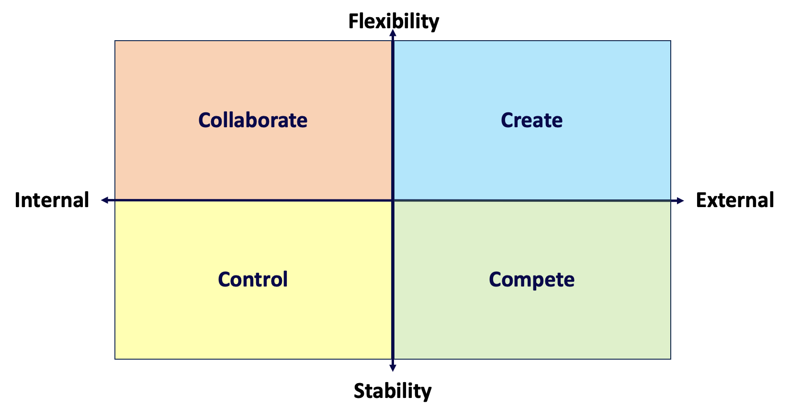
Desired Culture Gap
Partner
Employees

Slide 18
Desired Culture Gap
This gap captures how effective the firm/partners are at communicating the desired firm’s values.
We observe some notable (and statistically significant) differences:
Employees perceive that the firm’s desired values center more strongly on Control and less strongly on Collaboration.
Employees also perceive a stronger focus on Compete.
The gap widens as you move down the function levels (except staff level).
Notes:
Interpretation Point 3: this gap widens > the further you are removed from the ones who arguably set the tone for the org culture – the bigger the gap > it narrows again for the staff level, and specifically for those who recently joined: onboarding activities and new joiner trainings etc > reinforcement of the values

Slide 19
Lessons Learned #1
In order to establish the desired firm values, everyone in the organization needs a clear understanding of what these values are. This requires clear communication and continuous reinforcement.
Notes:
Given that there seems to be different perceptions of what the firm/partners want > clear communication & reinforcement

Slide 20
Current Culture Gap
Desired Culture
Current Culture

Slide 21
Current Culture Gap
The rough shape is overall roughly in line with the desired firm culture.
But, we also observe room for improvement:
The gap is largest for Collaborate
We also observe a gap for Compete and Create: For Compete, the current culture exceeds what is desired. For Create, it is lower.
Do these gaps matter? What could be potential negative consequences?

Slide 22



Current Culture Gap - Outcomes
Psychological Safety
The culture gaps are negatively related to these outcomes.
Perceived Organizational Support
Person-Organization Fit
Notes:
Briefly Explain why these outcomes and why THEORY would predict negative relations

Slide 23
Closing the Culture Gap – Embedding Mechanisms
Prior literature has identified different embedding mechanisms used to create a “quality-oriented” audit firm organizational culture
Tone at the Top
Performance Feedback & Reward Systems
Necessary Resources (Budgets & Staffing)
Training & Development
Organizational Design & Structure
Audit Processes
Emphasis on Collaboration & Consultations
Which embedding mechaanism can most effectively close the culture gaps identified with the CVF?

Slide 24
Embedding Mechanisms – Closing the Gap
Which embedding mechanism can most effectively close the culture gaps identified with the CVF?
It depends on the gap!
    Our analyses suggest that different embedding mechanisms matter for each of the dimensions of the CVF:
Collaborate
Control
Create
Compete
Resources
Training & Development
Tone at the Top
Resources
Audit Procedures
Resources
Feedback & Reward Systems
Organizational Design
Feedback & Reward Systems
Notes:
This is also in line with research in other areas documenting different leadership styles matter

Slide 25




Lessons Learned #2
It’s important to monitor and assess the current culture to identify whether the culture initiatives are successful and whether the firm achieves to establish its desired culture.
It’s important to listen to the employees – they might have a very different view of the current organizational culture.
Depending on the gaps assessed, firms might wish to emphasize different embedding mechanisms - not all desired values can be implemented in the same way
Walk the talk.

Slide 26
Conclusion
Study aims to provide more insights into understanding audit firm culture
We apply the ‘Competing Values Framework’ as our theoretical framework, offering a new perspective to the accounting literature to examine organizational culture.
Our study helps audit firms to monitor and assess their organizational culture in order to successfully establish a ‘quality-oriented’ firm culture.

Slide 27
Thank you

