Slide 1

Christian Peters
Nanyang Busniness School
Auditor automation usage and professional skepticism

Slide 2






Contents
Technological Developments in Auditing
20%
General
Behavioral Ramifications of Technology
Research Questions
80%
My Research
Hypotheses and Method
Discussion of Results
Contribution and Discussion

Slide 3
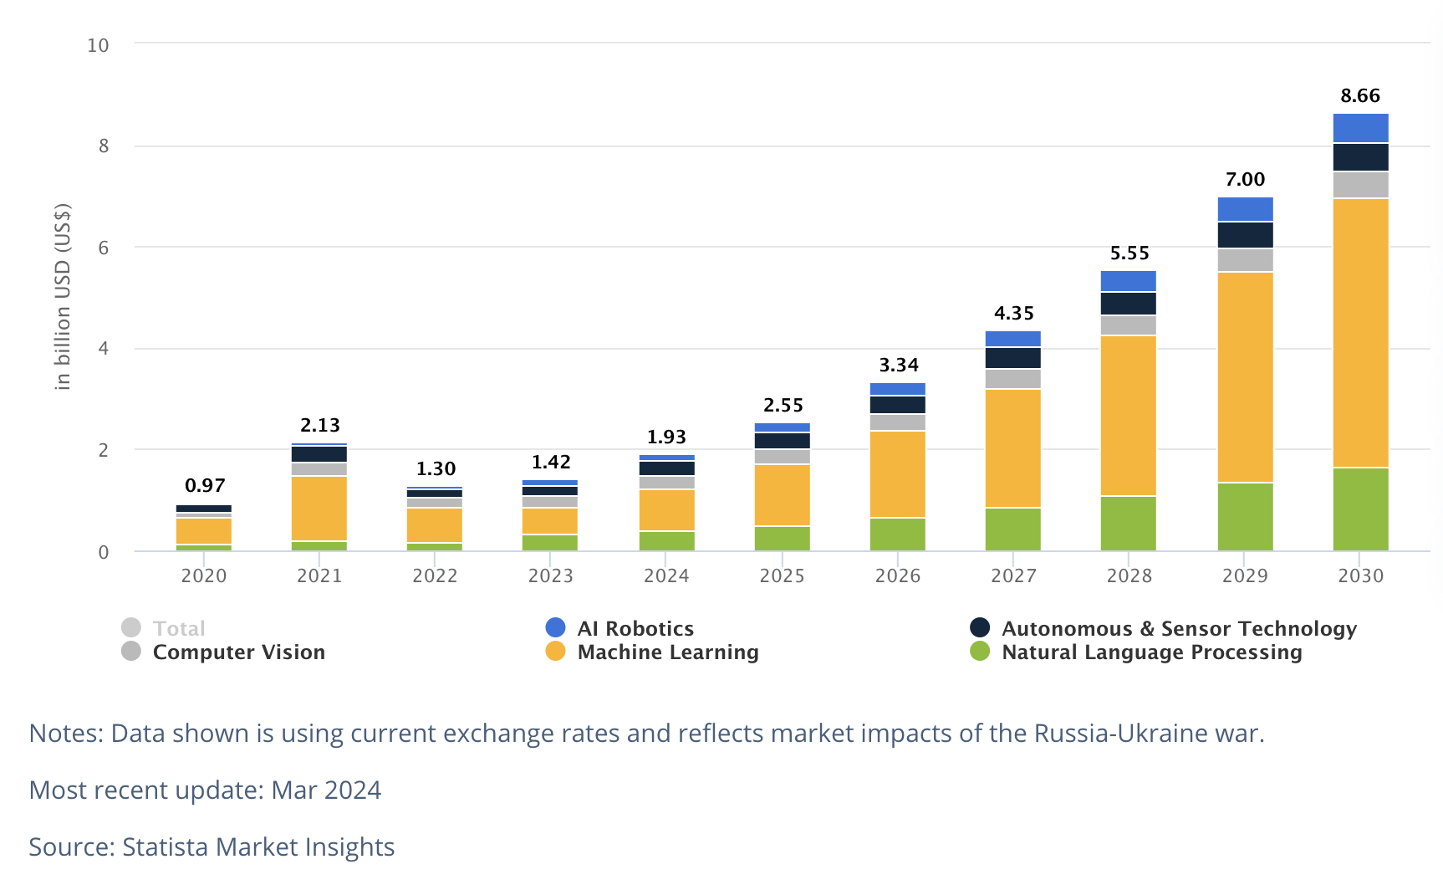
Notes:
Netherlands AI market size

Slide 4
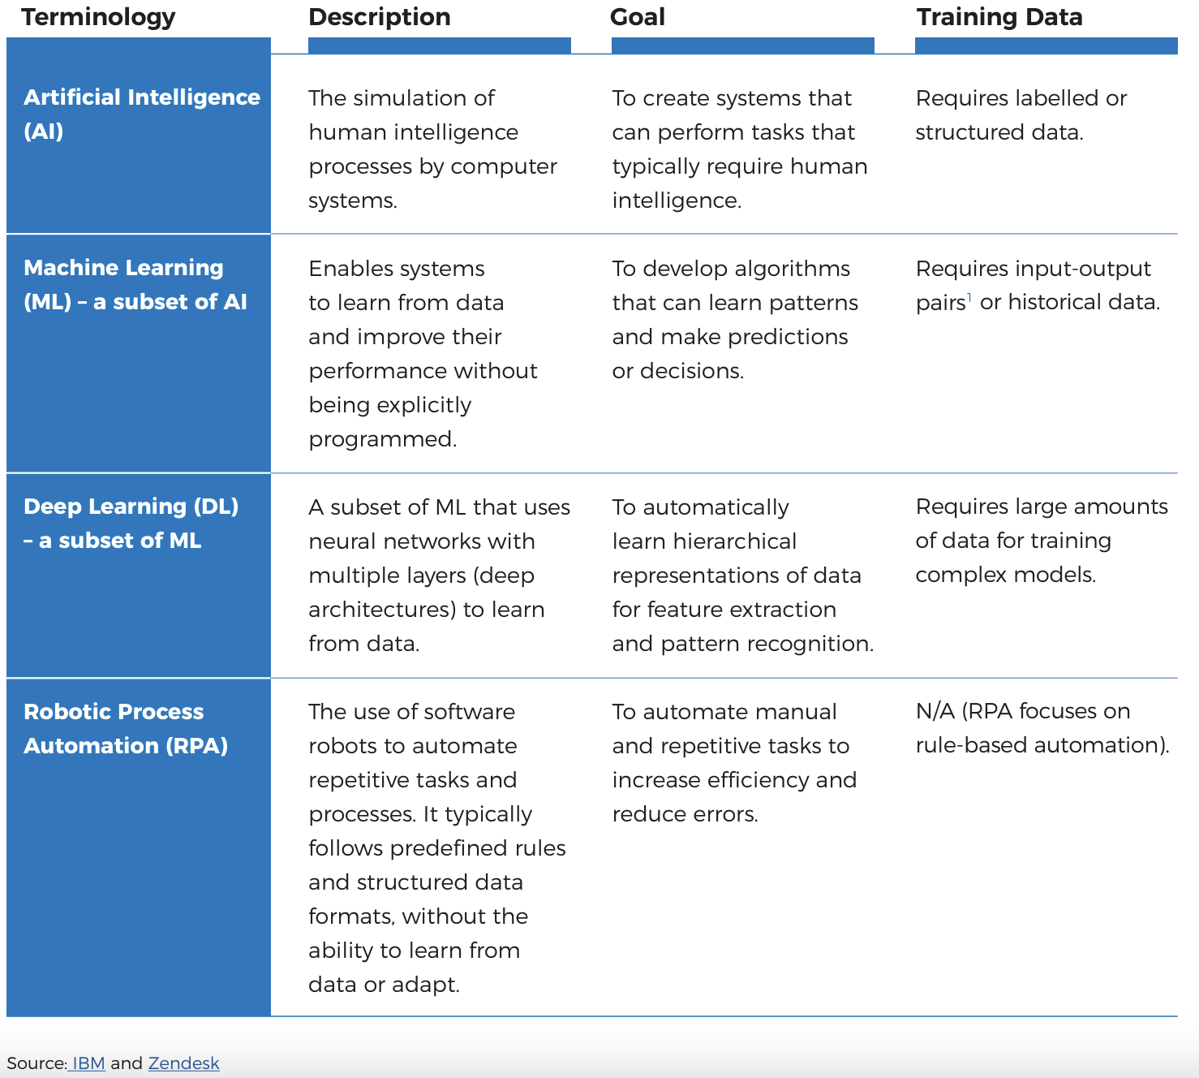

Slide 5
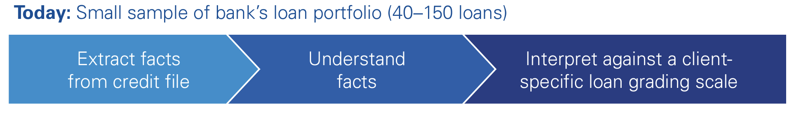
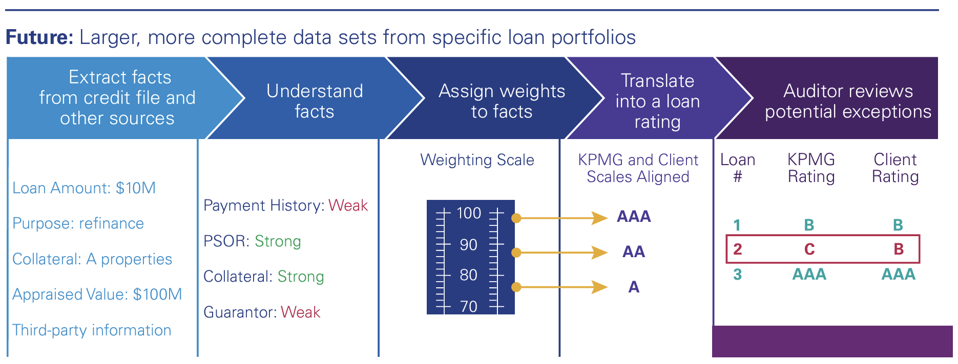
Source: KPMG (2016) Harnessing the power of cognitive technology to transform the audit

Slide 6

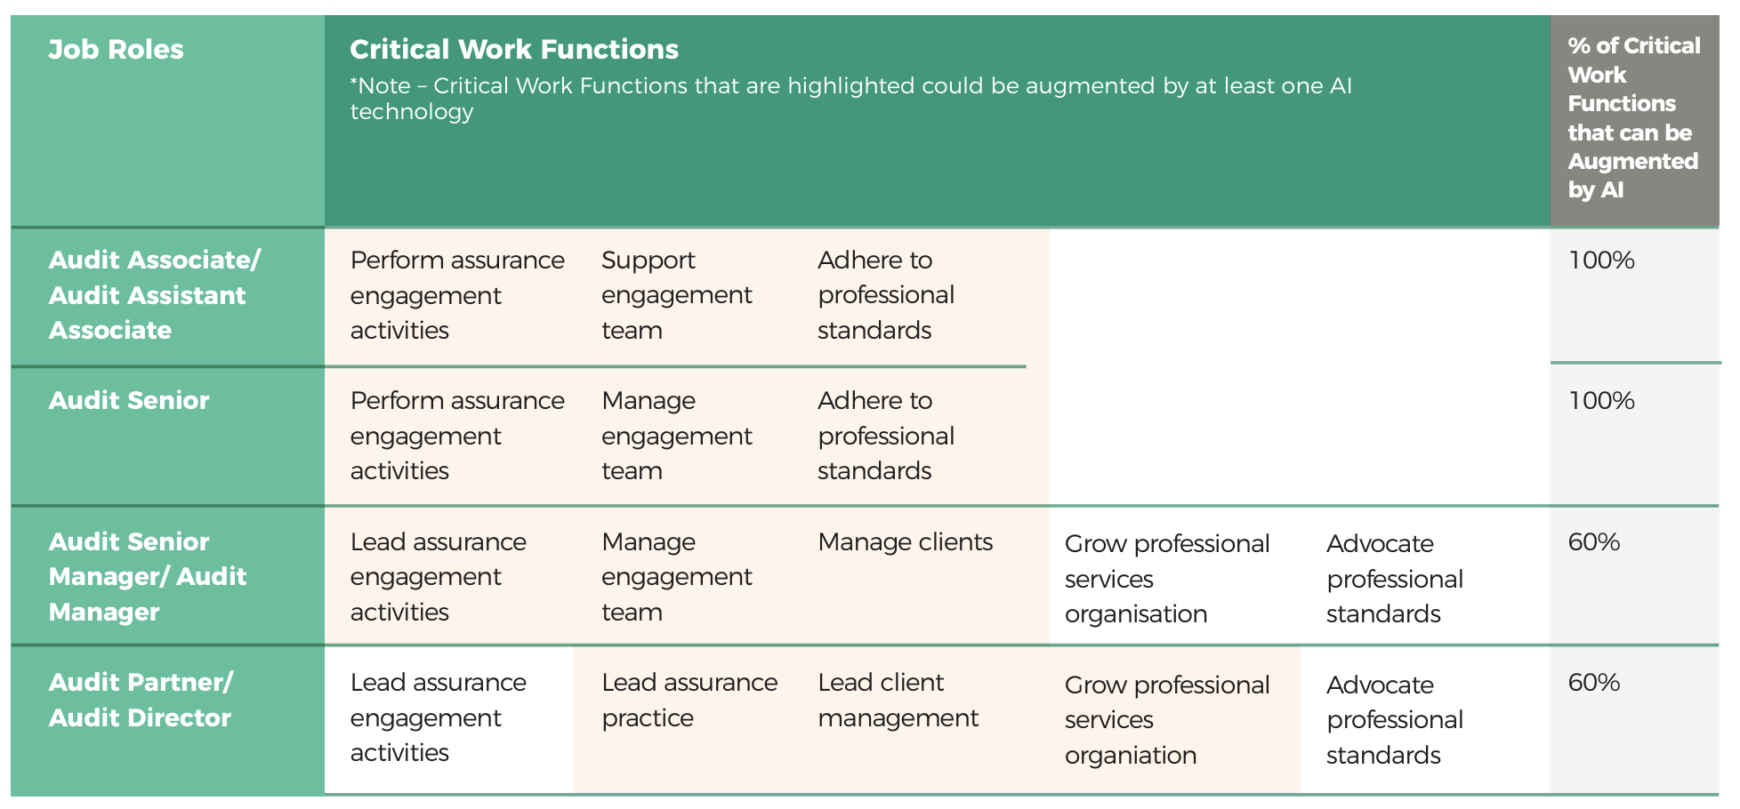

Slide 7
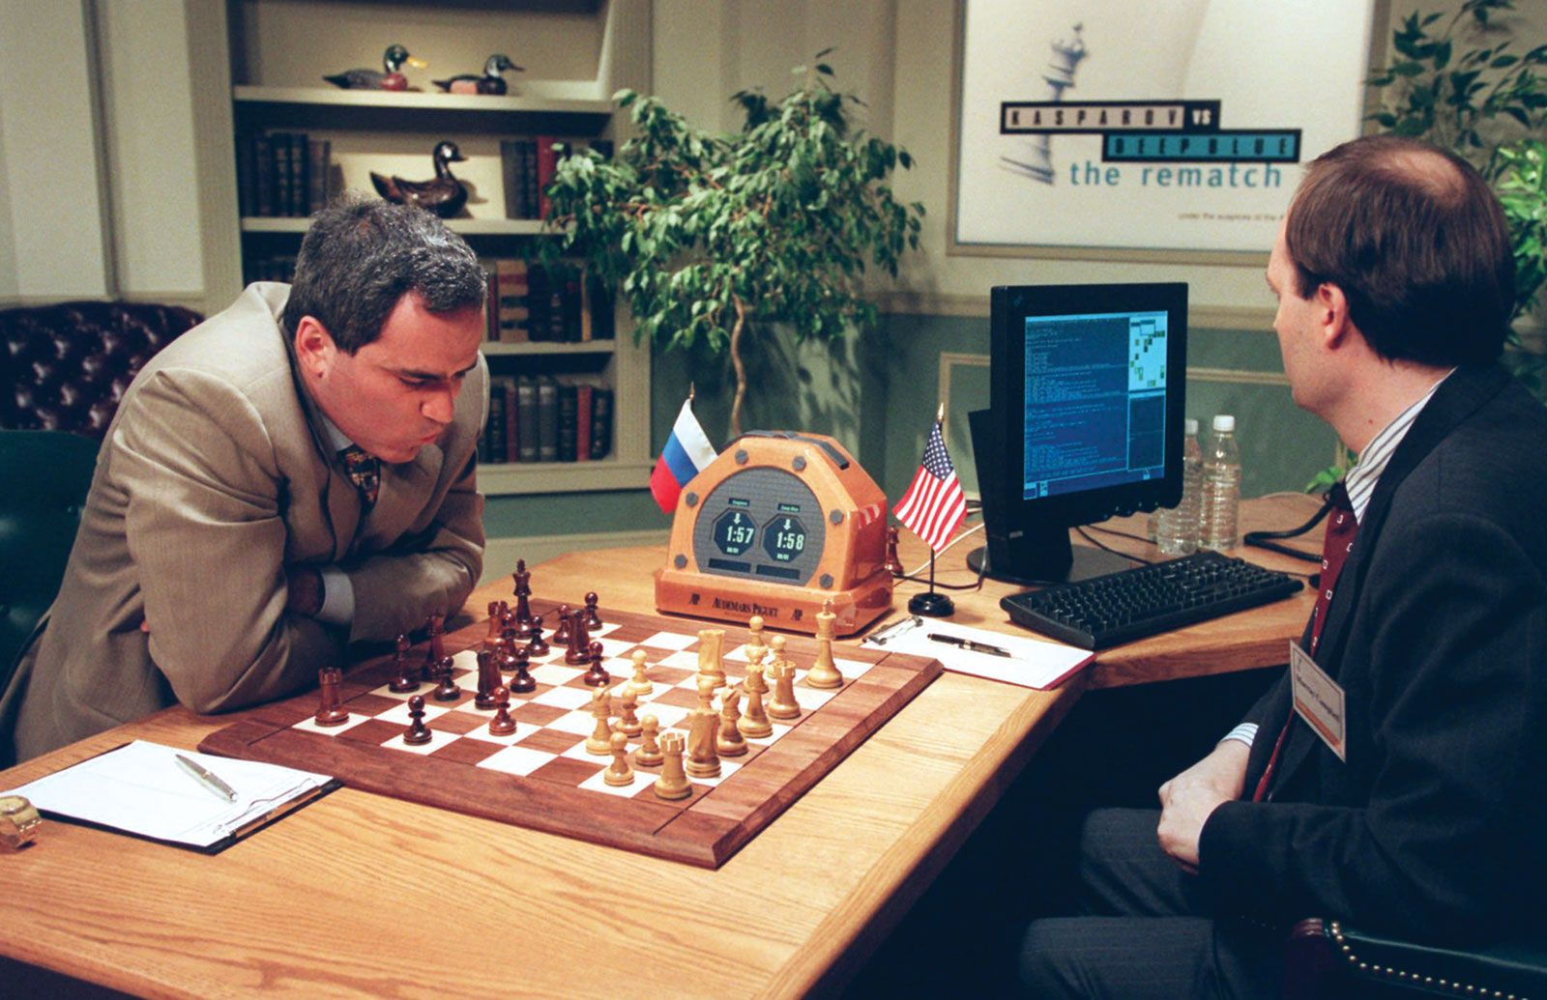

Slide 8

Notes:
Automation bias refers to a specific class of errors people tend to make in highly automated decision making contexts, when many decisions are handled by automated aids (e.g., computers), and the human actor is largely present to monitor on-going tasks. Highly automated decision making contexts include monitoring of nuclear power reactors, automatic pilots, and even spell checking programs. Omission errors occur when the human decision maker does not notice an automated decision aid failure (e.g., when a spell check program fails to alert the user of a misspelled word). A commission error is when the human decision maker fails to catch an active error of an automated decision aid (e.g., when a spell checker program suggests and incorrectly spelled word to replace a correctly spelled one).

Slide 9
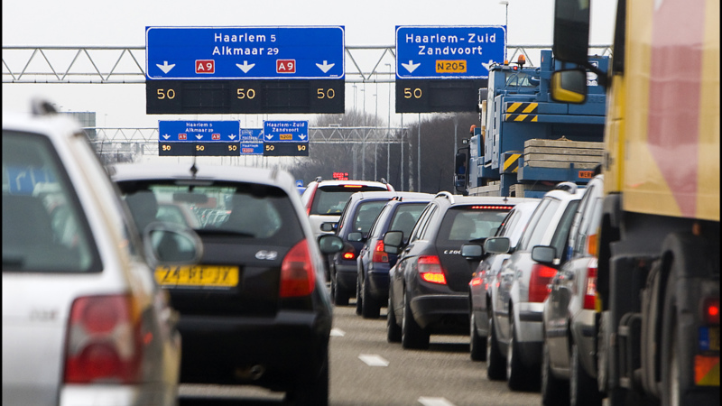
Algorithm
Aversion
FAR
Notes:
Imagine that you are driving to work via your normal route. You run into traffic and you predict that a different route will be faster. You get to work 20 minutes later than usual, and you learn from a coworker that your decision to abandon your route was costly; the traffic was not as bad as it seemed. Many of us have made mistakes like this one, and most would shrug it off. Very few people would decide to never again trust their own judgment in such situations. Now imagine the same scenario, but instead of you having wrongly decided to abandon your route, your traffic-sensitive GPS made the error. Upon learning that the GPS made a mistake, many of us would lose confidence in the machine, becoming reluctant to use it again in a similar situation. It seems that the errors that we tolerate in humans become less tolerable when machines make them. We believe that this example highlights a general tendency for people to more quickly lose confidence in algorithmic than human forecasters after seeing them make the same mistake.
People's tendency to mistrust or avoid using algorithms, especially when algorithms make mistakes.
Root causes:
Perceived Lack of Control: Feeling of losing control when decisions are automated.
Distrust in Technology: Skepticism towards machine ability to understand and incorporate human values and nuances.
Inability to Understand Algorithms: Complex and opaque nature of some algorithms, making them “black boxes.”
Underutilization of Technology: Failing to leverage beneficial, efficient automated systems.

Slide 10

Perfect Automation Schema
What causes algorithm aversion or automation bias?
  (i) errors or false positives, (ii) future vs. past-oriented, and (iii) egocentrism, (iv) competing information, (v) subjectivity/objectivity.

Slide 11
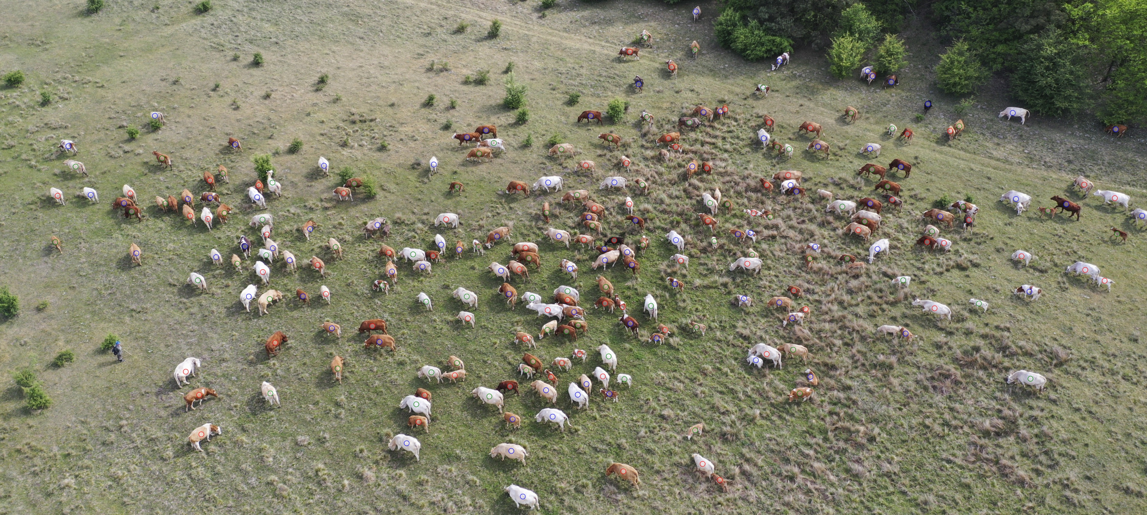
  Harris (2017): “Auditors should take care that they are not over relying on technology. As powerful as these tools are, or are expected to become, they nonetheless are not substitutes for the auditor’s knowledge, judgment, and exercise of professional skepticism.”
  IAASB (2021): “The use of technology may potentially create biases or a general risk of overreliance on the information or output of the audit procedure performed.”

Slide 12
Research questions
Are auditors more or less skeptical towards automation than towards their colleagues? (Automation Bias)
Is there an intervention that can alleviate the effects of automation?
Do the effects of automation on auditor professional skepticism spill over to unrelated tasks?
Notes:
Why is it important?
Benefits of automation only fully materialize if auditors utilize it in an appropriate way.
Most research focuses on potential lower reliance on automation (Dietvorst et al. 2015; 2018; Emett et al. 2021; Cao, Duh, Tan, and Xu 2022; Commerford et al. 2022)
This study examines the effect of automation usage on professional skepticism and predicts that auditors may rely to a greater extent on automation than on human colleagues.

Slide 13
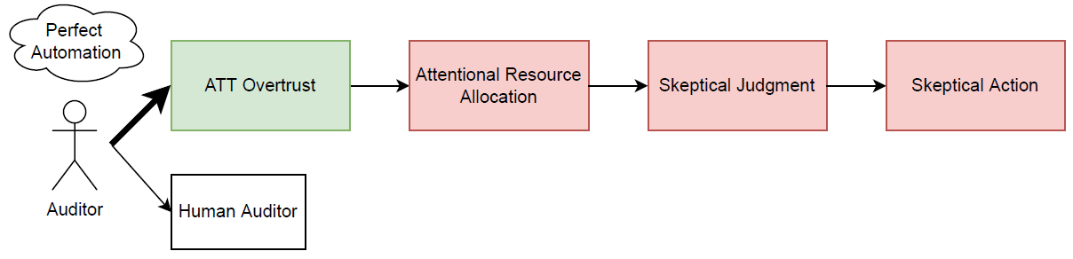
Hypotheses and Method
Perfect Automation Schema
(e.g., Parasuraman and Riley 1997; Dijkstra 1998; Dzindolet et al. 2002; Onnasch et al. 2014; Lyons and Guznov 2019)
Attentional Resource Allocation / Automation Bias
(e.g., Mosier and Skitka 1996; Parasuraman and Riley 1997; Parasuraman and Manzey 2010)
Attention and Skepticism
(e.g., Nelson 2009; Nolder and Kadous 2018)

Slide 14
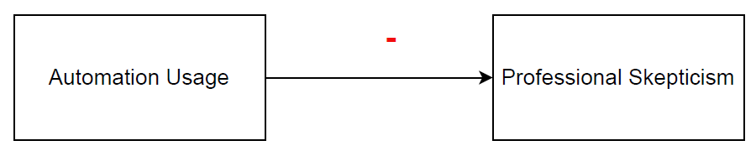
Hypotheses and Method
Hypothesis 1

Slide 15
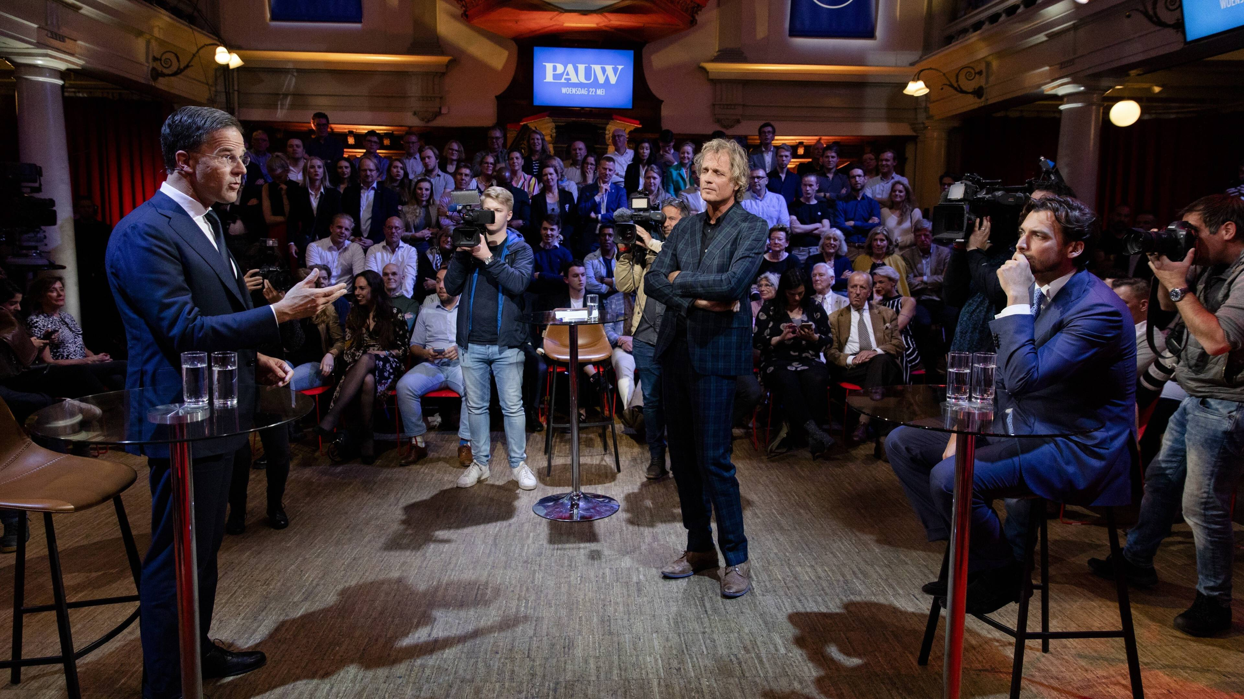

Notes:
I propose a counterarguing mindset intervention.
A counterarguing mindset is a state of mind in which individuals generate reasons why a proposition is not true or a state of affairs could not occur. For example of politicians and commercials.
This effect is more impactful when the behavior in the presence of a counterarguing mindset differs more from that in the absence of a counterarguing mindset. For instance, when auditors believe that automation operates at a nearly perfect rate, counterarguing may lead to more belief revision than when auditors have a more nuanced expectation.

Slide 16
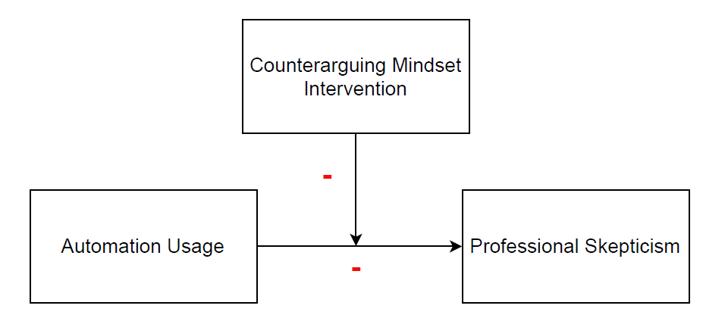
Hypotheses and Method
Hypothesis 2
Notes:
The study has three main aims. The first aim of the study is to examine how auditors’ automation usage affects their professional skepticism. I compare the professional skepticism exercised towards work conducted by automated tools and techniques compared to the same work conducted by a human colleague. My prediction and finding is that in audit tasks, auditors are less skeptical towards work conducted by the audit firm’s automated tools and techniques than to the same work conducted a human colleague. I will dive into the mechanism for this later.
Hypothesis 2: The negative effect of automated tools and technologies usage on professional skepticism is weakened when auditors are prompted with a counterarguing mindset.

Slide 17
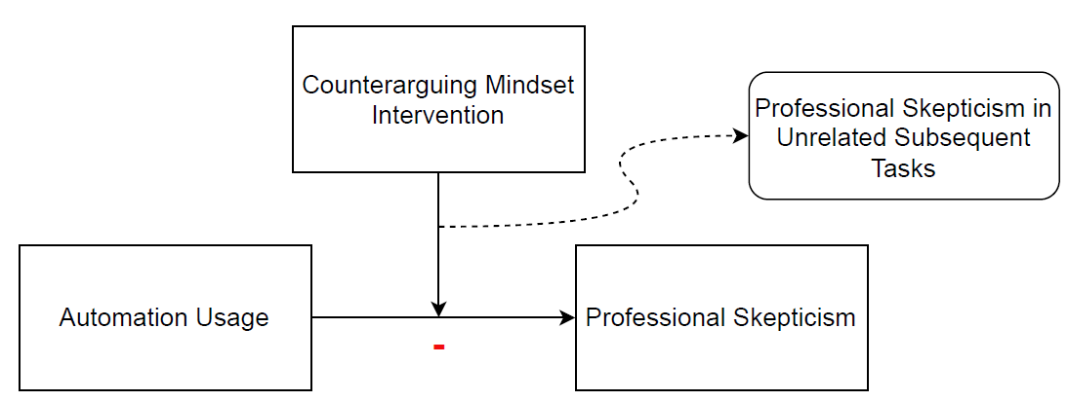
Hypotheses and Method
Hypothesis 3
Notes:
The study has three main aims. The first aim of the study is to examine how auditors’ automation usage affects their professional skepticism. I compare the professional skepticism exercised towards work conducted by automated tools and techniques compared to the same work conducted by a human colleague. My prediction and finding is that in audit tasks, auditors are less skeptical towards work conducted by the audit firm’s automated tools and techniques than to the same work conducted a human colleague. I will dive into the mechanism for this later.
Hypothesis 2: The negative effect of automated tools and technologies usage on professional skepticism is weakened when auditors are prompted with a counterarguing mindset.

Slide 18
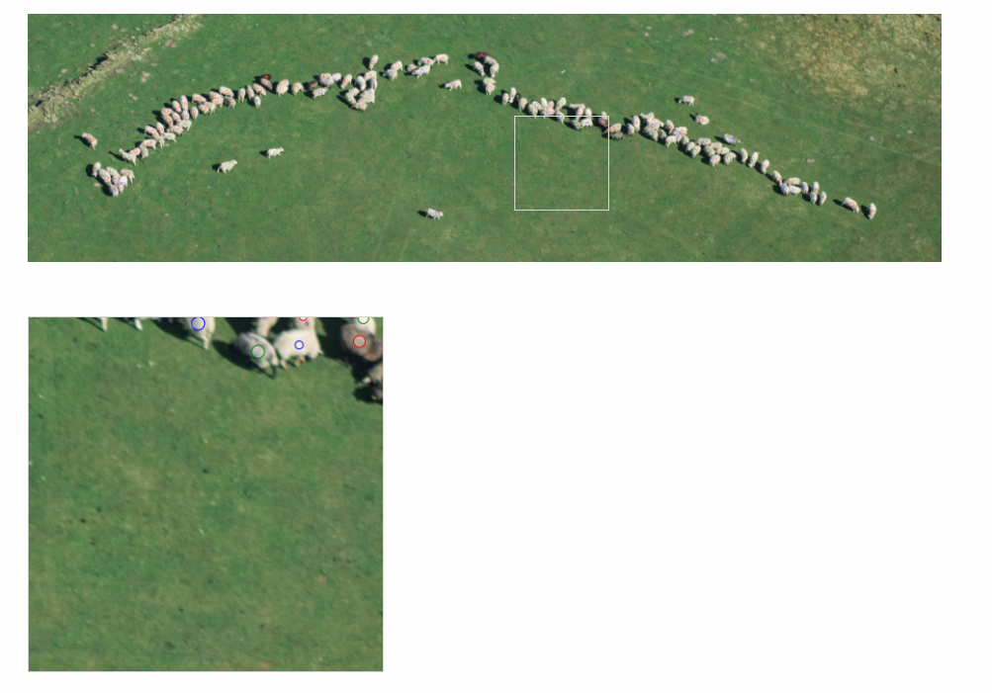

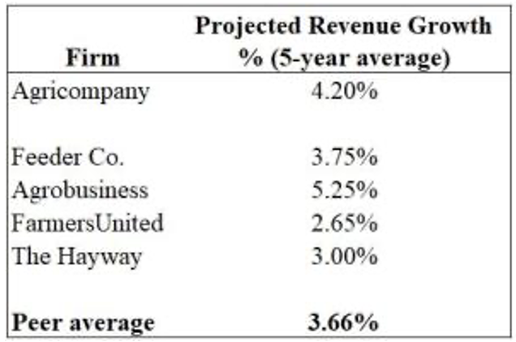
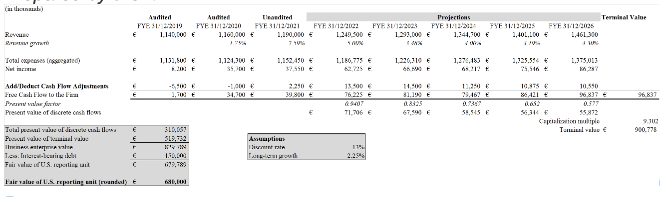

Hypotheses and Method
Notes:
Recruited 114 staff auditors.

Slide 19
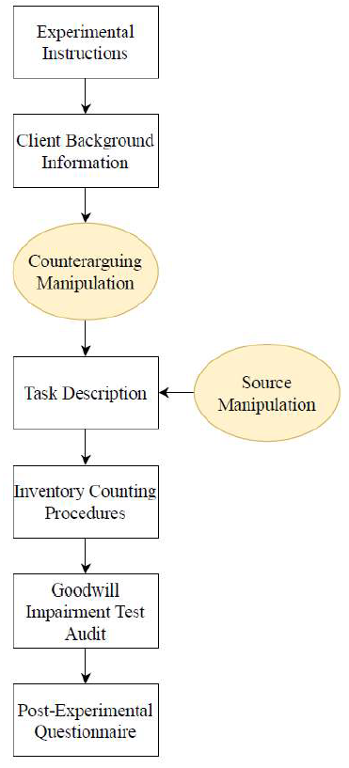
Hypotheses and Method
Notes:
The study has three main aims. The first aim of the study is to examine how auditors’ automation usage affects their professional skepticism. I compare the professional skepticism exercised towards work conducted by automated tools and techniques compared to the same work conducted by a human colleague. My prediction and finding is that in audit tasks, auditors are less skeptical towards work conducted by the audit firm’s automated tools and techniques than to the same work conducted a human colleague. I will dive into the mechanism for this later.
Hypothesis 2: The negative effect of automated tools and technologies usage on professional skepticism is weakened when auditors are prompted with a counterarguing mindset.

Slide 20
Hypotheses and Method
Counterarguing Manipulation
Counterarguing Mindset
Control
Notes:
The study has three main aims. The first aim of the study is to examine how auditors’ automation usage affects their professional skepticism. I compare the professional skepticism exercised towards work conducted by automated tools and techniques compared to the same work conducted by a human colleague. My prediction and finding is that in audit tasks, auditors are less skeptical towards work conducted by the audit firm’s automated tools and techniques than to the same work conducted a human colleague. I will dive into the mechanism for this later.
Hypothesis 2: The negative effect of automated tools and technologies usage on professional skepticism is weakened when auditors are prompted with a counterarguing mindset.

Slide 21
Hypotheses and Method
Notes:
The study has three main aims. The first aim of the study is to examine how auditors’ automation usage affects their professional skepticism. I compare the professional skepticism exercised towards work conducted by automated tools and techniques compared to the same work conducted by a human colleague. My prediction and finding is that in audit tasks, auditors are less skeptical towards work conducted by the audit firm’s automated tools and techniques than to the same work conducted a human colleague. I will dive into the mechanism for this later.
Hypothesis 2: The negative effect of automated tools and technologies usage on professional skepticism is weakened when auditors are prompted with a counterarguing mindset.

Slide 22
Hypotheses and Method
Source Manipulation
Automation
Human
Notes:
The study has three main aims. The first aim of the study is to examine how auditors’ automation usage affects their professional skepticism. I compare the professional skepticism exercised towards work conducted by automated tools and techniques compared to the same work conducted by a human colleague. My prediction and finding is that in audit tasks, auditors are less skeptical towards work conducted by the audit firm’s automated tools and techniques than to the same work conducted a human colleague. I will dive into the mechanism for this later.
Hypothesis 2: The negative effect of automated tools and technologies usage on professional skepticism is weakened when auditors are prompted with a counterarguing mindset.

Slide 23
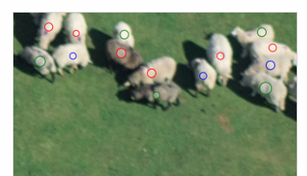
Method
Time Spent
Agree with Preparer
Seeded Errors Identified
Inventory Counting Task
Dependent Variables
Notes:
Discussion about structured tasks.

Slide 24
Method
Reasonableness
Seeded Issues (deep and surface)
Contact Supervisor Directly
Goodwill Impairment Test
Dependent Variables
Five Issues
Benchmarking – Growth rate
Sensitivity Analysis
Growth not consistent with market outlook
Company over-projected growth in past years
New competing product and production delays
Notes:
Discussion about structured tasks.

Slide 25
Discussion of Results (Hypothesis 1)

Slide 26
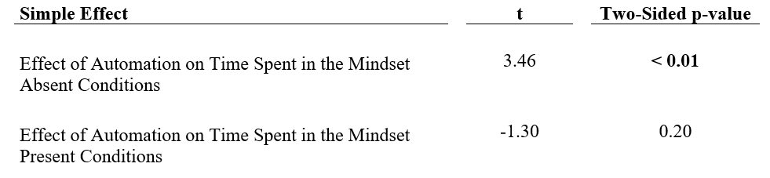
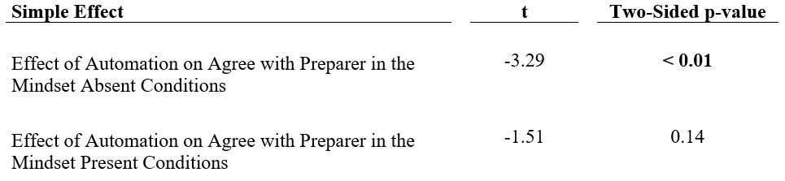
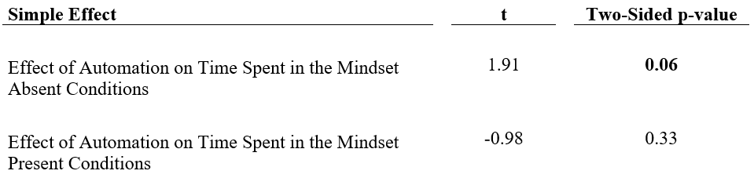
Discussion of Results (Hypothesis 1)
Time Spent
Agree with Preparer
Seeded Errors Identified
Hypothesis 1: ✓ Auditors tend to be less skeptical towards automation than other audit professionals.

Slide 27
Discussion of Results (Hypothesis 2)
Time Spent
Agree with Preparer
Seeded Errors Identified

Slide 28
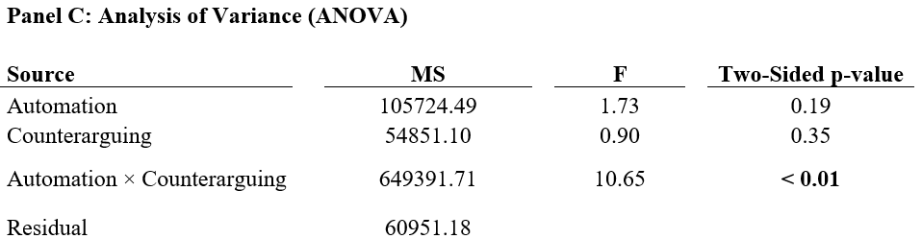
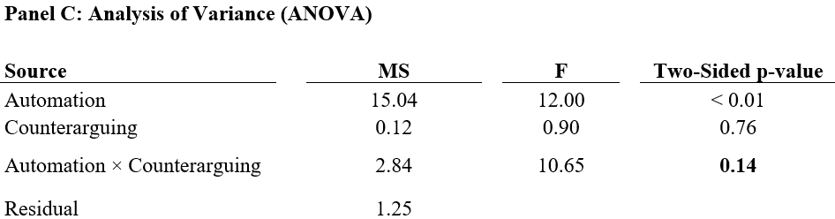
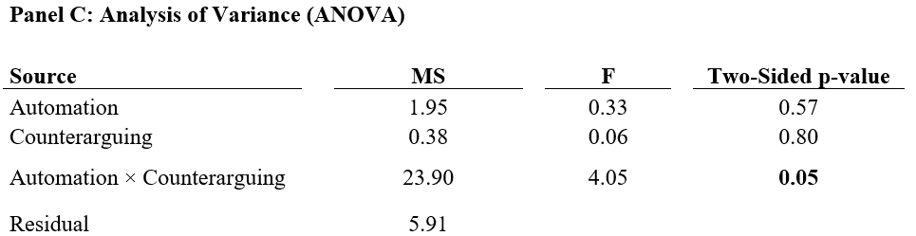
Discussion of Results (Hypothesis 2)
Time Spent
Agree with Preparer
Seeded Errors Identified
Hypothesis 2: ✓ The negative effect of automated tools and technologies usage on professional skepticism is weakened when auditors are prompted with a counterarguing mindset.

Slide 29
Discussion of Results (Hypothesis 3)
Hypothesis 3: × Auditors exhibit less professional skepticism in a subsequent unrelated task when they relied on automated tools and technologies in a previous task.

Slide 30




Contribution and Discussion
Auditor Automation Usage and Professional Skepticism
Auditors are less skeptical when relying on the audit firm’s automated tools and techniques than on another audit professional.
Audit firms can use a counterarguing mindset intervention to reduce the negative effect of automation usage on professional skepticism.
No evidence for a spillover effect to other audit tasks.
Findings help audit firms and regulators navigate the difficult trade-offs when adopting automation in the audit.
Notes:
Adds to a nascent but growing stream of literature on technology adoption and usage in auditing.
Contributes to the literature on professional skepticism

Slide 31

Thank you

