Slide 1
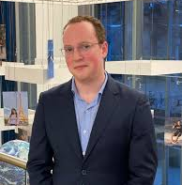
Iver Wiertz Maastricht University
Virtual Audit Teamwork: Working, Learning, and Delivering High-Quality Audits Virtually

Slide 2
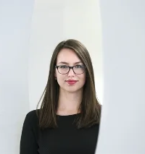
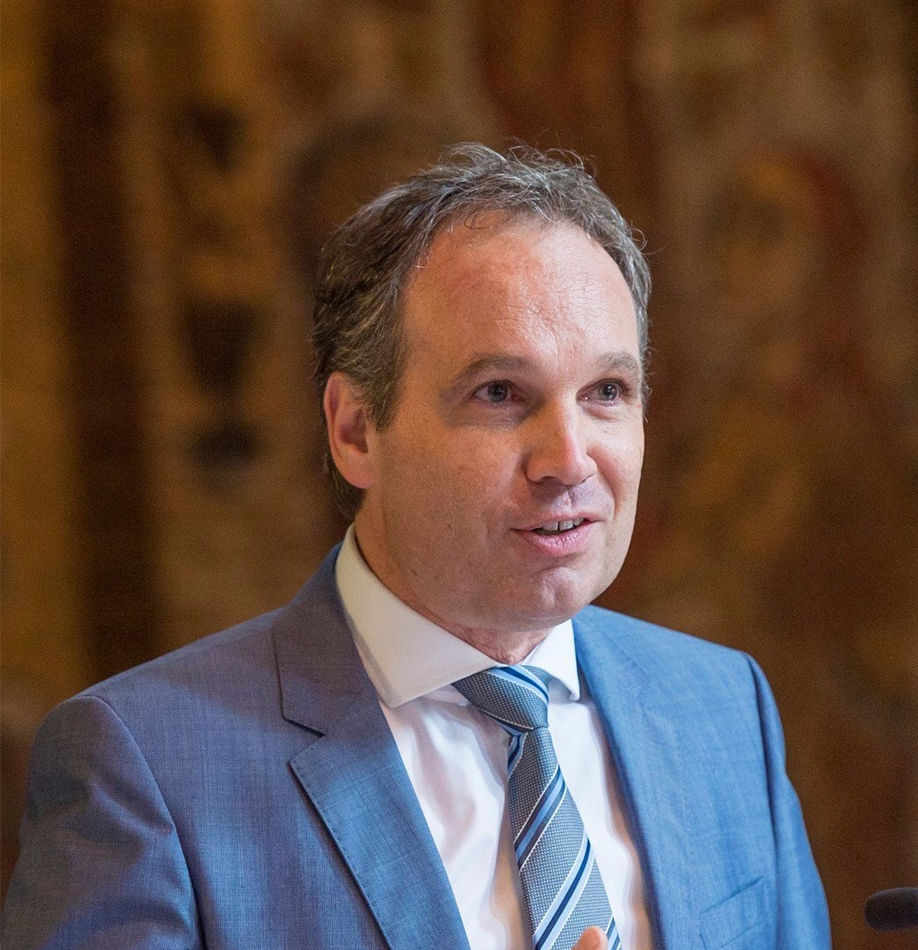
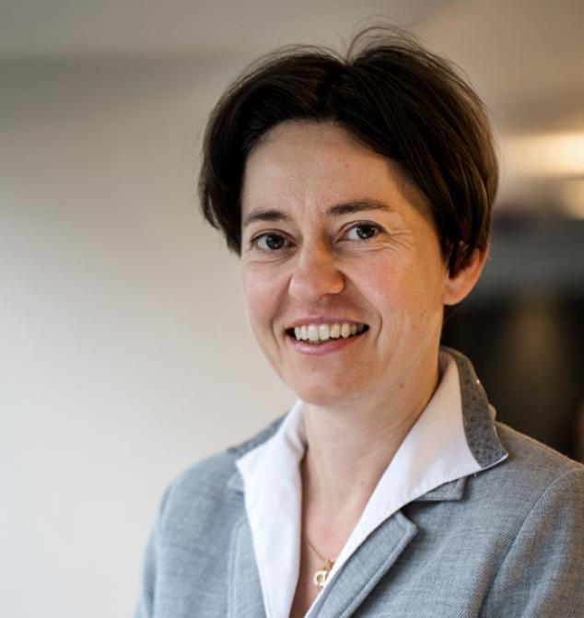
Author team
Wim Gijselaers
Therese Grohnert
Roger Meuwissen
Ann Vanstraelen
Notes:
Thank everyone for allowing me to be here today and to be able to share my work with this audience. I still remember sitting in the room here a couple years ago contemplating whether I wanted to do a PhD or not and I was sitting over there witnessing what was going on and I got inspired, and now to be on the other side room sharing with you what I have done together with my supervisors Ann, Therese, Wim and roger feels like an absolute priviledge.
When developing this presentation I was thinking about the responsibility the last spot on the program before dinner and I though what can I do to keep this hungry audience interested in what I have to tell them. So I thought to start off with with something that foreshadows a little bit what is going to happen after this, namely dinner

Slide 3
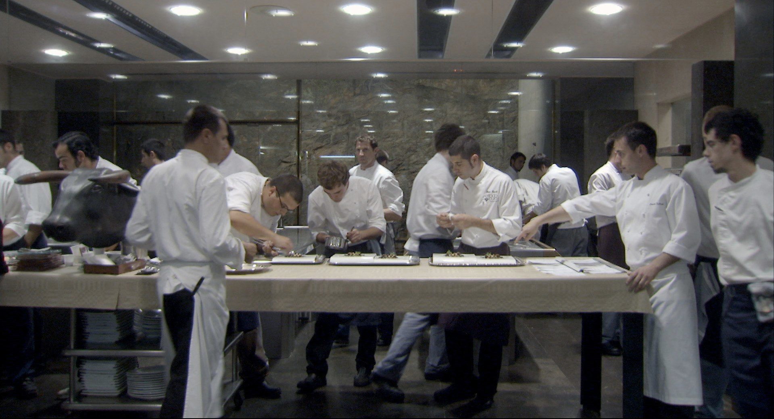
Notes:
And for those of you who don’t know me, I have a background in gastronomy, particularly working in kitchens.
So I thought let’s talk about what we see on this picture.
In the middle, we see several chefs working together each handling one component combining them to create the full dish
On the sides we see the two chefs, check give direction and check wheter the dish is prepared in line with the vision of the chef
We know that these two people are the chef as they wear white aprons and the rest wears blue aprons, displaying and reinforcing their place in the hierarchy
On the right side we see a cook peer over the shoulder of a chef, trying to understand what is going on and seeing how the chef is leading the kitchen.
What do we learn about the food in this picture? First of all we see that there are a lot of chefs in the kitchen (I counted 19 people in this picture), on the left we see a statue of a bull, suggesting that this restaurant is called El Bulli, one of the most exclusive and innovative restaurants that has ever existed. This is a restaurant with a reputation for excellence to uphold.
For me this one picture captures a lot about the essence of teamwork. For me, this picture is a general metaphor for what teamwork can do, namely realise things I could never do by myself, and what it takes to make teamwork succeed.
And I am certain that all of you in the room here today recognizes something happening in this picture here in your work as auditors or researchers.
It might be that people have different tasks that their individual inputs need tto be brought together for the unit to succeed
It might be that you are observing the people around you and learning from what they are doing
It might be that you are a leader and that you have to keep an eye on what is being done and whether the output meets the

Slide 4
Notes:
But then corona happened and EVERYTHING changed.
And although at the humanistic level, the COVID-19 pandemic was challenging and we collectively suffered, it has been a fruitful time as well.
It pushed a wide variety of businesses to change their operation and find new ways of doing things. Some companies, like those restaurants had to find new ways to be relevant and survive, medical companies had to figure out how to develop and distribute new vaccines and medicine, and other firms, such as auditing firms, had to find a way they could do their job well without being in the office or at the client anymore.

Slide 5
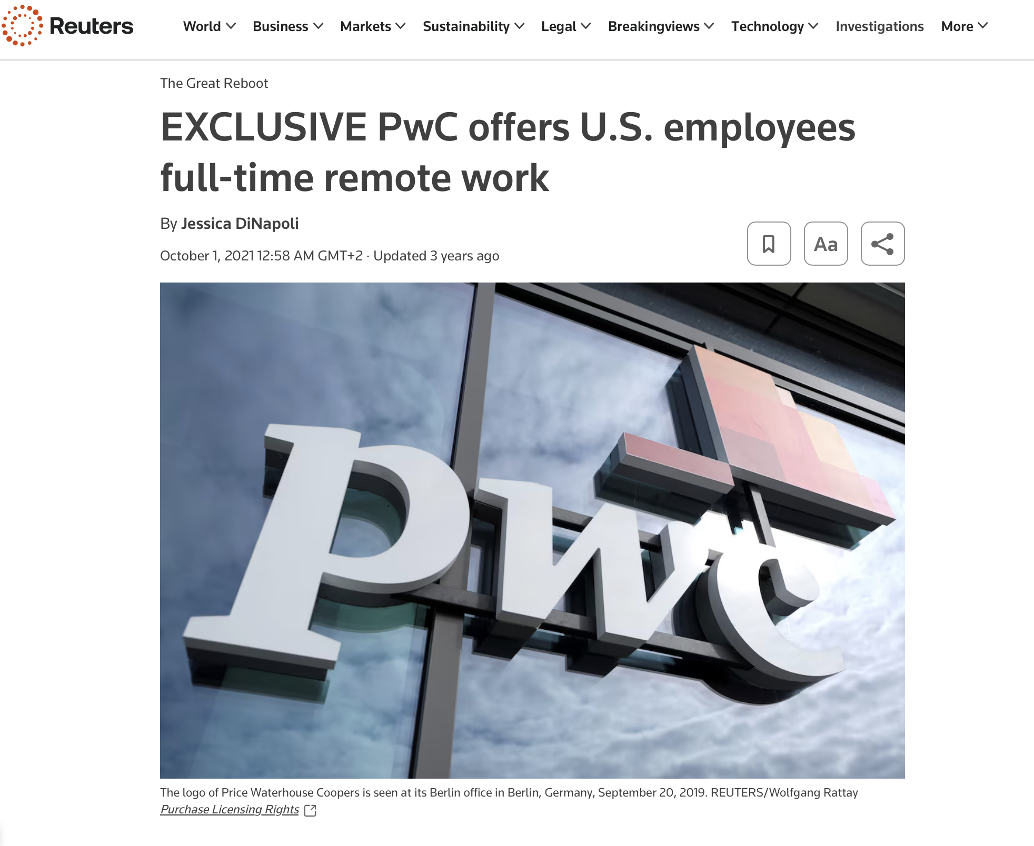
Notes:
And that the shift to working remotely has been profound, is demonstrated by the profession. Here you see a post that PWC US offers their employees the opportunity to work remotely all the time and we have seen a somewhat similar development in Europe too.

Slide 6
Notes:
Seeing that a large degree of remote work is the norm now, let’s go back to our previous example of teamwork and try to image the implications of this move.
First we need to make a small alteration to the picture above →Show lines
Considering that we are now no longer in the same room, and can not see eachother anymore let’s see what happens.
Combining the individual tasks becomes much harder, the three guys in the middle
Supervising your coworkers and assisting them where necessary becomes much harder.
Peeking over the shoulder from your supervisor is no longer an issue
But the expectations and the loss of reputation stay the same whether you are together.
And I think that these are things that you all recognize too from your daily practice and this shows us that although we have been transitioning in new ways of working after the COVID-19 pandemic there might be risks involved and but that we might not fully understand what this impact this way of working will have in general, but also for the auditing profession specifically.
And this tension is what we tried to address with the FAR project

Slide 7
Virtual audit teamwork: Working, learning, and delivering high-quality audits virtually
Understand
Explain
The impact of virtual teamwork on the auditing profession
The mechanism behind variation in team performance
Notes:
Because we realized quickly in March 2020 that this was a unique situation. A completely new way of working and a sort of natural experiment that was unprecedented. So, with the motto to never waste a good crisis, we started developing this FAR project with two goals in mind.
On the one hand, we wanted to understand how this new way of working is shaping the profession and where we might expect its impact to manifest.
On the other hand, we also wanted to see if we could translate this understanding into a mechanism of where we could help explain how differences between virtual teams start to exist and how we could potentially improve their performance.

Slide 8
What is a virtual team?
Virtual Team
Team
Dispersion
Technology
(Townsend, DeMarie, & Hendrickson, 1998, p.17).
Notes:
Ok, so that is our project and its goals. Let’s talk briefly about the theory and phenomena behind this project. We have used the terms ‘virtual teamwork’ and ‘virtual team’ in the title and you will be hearing these terms quite a bit more today so it is going be useful to define what we mean with them properly. So let’s talk about what a virtual team is. (Show box virtual team)
A virtual is first and foremost a team, a group of people working towards a shared goal and relying on each other to reach that goal. The image you saw in the first picture of the team.
Then the second characteristic of a virtual team is that the team members encounter some form of dispersion, could be that they are at a separate geographic location, could be that they work for different parts of the organization, or it could be that they work at different times or different time zones. This reminds me more of the second picture of the team in the kitchen I showed with the red lines separating individual team members.
The third characteristic is that team members overcome the barriers of dispersion using information technology, such as MS Teams, and Zoom, but also email, instant messaging, or a phone call.
Related to this is of course virtual teamwork, as virtual teamwork is the process of a virtual team engaging with their task.
Now this phenomenon of the virtual team is not completely new to the auditing profession, there is ample experience with virtual teamwork in international group audits and offshoring.

Slide 9
Literature
Previous literature investigated remote auditing (Ma, Wang & Wu 2023; Causholi, Cheng & Golshan 2023; Jin, Tian, Wu & Xin 2022; Downey Obermire & Zehms 2020).
Specific challenges related to remote work during a global pandemic:
- The socialization of junior auditors (Tighe, 2023; Booker, Hawkins, Vandervelde & Wu 2022)
- The response to auditability challenges (Luo & Malsch 2023)
- The position of female auditors during the pandemic (Ghio, Moulang, Gendron 2023).
We need more evidence on the factors that impact a virtual audit team’s performance (Bauer, Humphreys & Trotman 2022; Wiese, Burke, Tang, Hernandez & Howell 2021).
Notes:
We are also not the first trying understand what it means to audit remotely, or not to waste a good crisis. We have quite some information about auditing in a remote environment related to the pandemic
For instance, there has been quite a bit of attention to specific pandemic-related auditing situations such as the socialization and onboarding of junior auditors, how the profession dealt with challenges to due to the pandemic, and how working from home during the pandemic has particularly impacted female auditors in their work.
We do still need more work with rich evidence trying to understand the lived experiences and the perceptions of practitioners of how the processes within the team are impacted by virtual teamwork, and particularly the type of virtual teamwork we do now and not during the height of the pandemic, and explain and explore how we can ensure a high-quality audit under these conditions

Slide 10
Virtual audit teamwork: Working, learning, and delivering high-quality audits virtually
Understand
Explain
- Interviews
- 37 auditors
- All ranks
- Thematic analysis
- Surveys
- 833 auditors
- Two rounds
- SEM
Notes:
Because we realized quickly in March 2020 that this was a unique situation. A completely new way of working and a sort of natural experiment that was unprecedented. So, with the motto to never waste a good crisis, we started developing this FAR project with two goals in mind.
On the one hand, we wanted to understand how this new way of working is shaping the profession and where we might expect its impact to manifest.
On the other hand, we also wanted to see if we could translate this understanding into a mechanism of where we could help explain how differences between virtual teams start to exist and how we could potentially improve their performance.

Slide 11
Interviews
Understand the impact of Virtual Teamwork on the auditing profession
Notes:
Now you know the why, the what and the how of this FAR project, let’s talk about those individual parts of the project and let’s start with the interviews.
As mentioned before it wat the intention of getting an rich understanding of how virtual teamwork is experienced in the auditing profession, and we used these interviews not only to enhance our understanding of virtual teamwork but also as a starting point for our surveys later on.

Slide 12
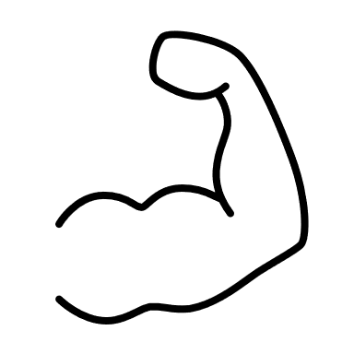
Perceptions of virtual teamwork
Virtual teamwork
Is a viable way of working
The negative impact is perceived as limited
There are skeptics but still find quality sufficient
Notes:
Given the opportunity here today I will mainly focus on some of the high-level outcomes of the interviews.
The first thing we found is basically that virtual teamwork is considered a viable way of performing an audit. We have seen a transition from remote working not being implemented widely in the heart of the engagement, to now being widely spread.
Second, our interviewees mention that they perceive the impact of virtual teamwork on the quality of an audit to be limited. We see quotes here along the lines of: control is a control, whether we perform it remotely or not.
This doesn’t mean that there are no dissenting voices. We do have a minority of people express concerns about the more intangible nature of control and that they have less context to the judgments they are forming, but even the skeptics still perceive the quality of an audit to be more than sufficient.
What I would like to stress is that this is the perception of our respondents, and not necessarily ours or correct. But considering that people were anonymous and we have dissenting voices, we do think that this is an authentic reflection of the perceptions of the interviewees and not just self-serving bias.

Slide 13
The advantages and disadvantages of virtual teamwork
Reduced carbon emissions
Improved work/life balance
Less office space needed
Fewer distractions
Increase flexibility
Local availability of global talent
Cost reductions
Decreased commute
Diminished contextual understanding
Reduced efficiency of teamwork
Decreased communication
Increased challenges of management
Reduced visibility of leadership
Advantages
Disadvantages
Notes:
Now I would like to zoom in on the value proposition of virtual work. As we gather from the example I gave earlier, virtual teamwork is not without downsides, but there must be considerable advantages too, otherwise we would not be tempted to even propose to work in a virtual manner.
From literature we already know what kind of advantages and dis advantages we can expect, carbon emmisions and flexibility for instance as advantages, but decreased communication, and a decreased understanding contextual understanding as a disadvantage.
However, what we found out is that a wide spread implementation of virtual teamwork involves more trade-offs than those that we already know. Turns out that in reality what the value proposition that auditors are trying to balance is more complicated and looks more like this → shows expanded

Slide 14
The advantages and disadvantages of virtual teamwork
Increased formalized learning
Increased span of control
Increased availability managers
Improved connection components
Improved digitalisation
Increased individual productivity
Increased learning from mistakes
Better preparation client
Improved meeting structure
Reduced carbon emissions
Improved work/life balance
Less office space needed
Fewer distractions
Increased flexibility
Local availability of global talent
Cost reductions
Decreased commute
Increased emphasis on review activities
Diminished binding with firm
Increased perceived firm control
Increased work pressure on management
Reduced justifiability of invoicing
Decreased interactions clients
Decreased motivation coworkers
Reduced build-up of social capital
Increased obscurity of fraud
Increased pressures to be available
Increased exhaustion
Additional challenges first-year auditors
Diminished contextual understanding
Reduced efficiency of teamwork
Decreased communication
Increased challenges of management
Reduced visibility of leadership
Advantages
Disadvantages
Notes:
So in trying to understand what is the impact of virtual teamwork on the auditing profession, we extended the list of advantages and disadvantages significantly, while we also show that striking a balance between these advantages and disadvantages becomes increasingly complex.

Slide 15
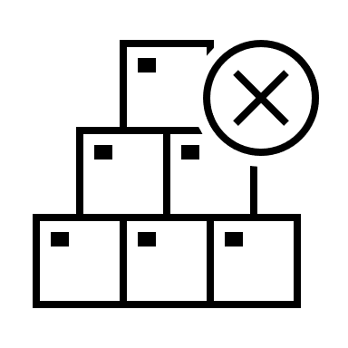
The pros and cons of virtual teamwork
Pros and cons manifest
different levels
Individual differences exist
Notes:
But there was another thing that we noticed though. Our data seems to suggest that there is a difference in where the advantages and the disadvantages are being experienced.
For instance, for the individual auditor, it is incredibly beneficial that their travel time can be reduced, and for the firm, it is and advantage that there is more global pool of auditors to draw from or that virtual teamwork can lead to, but at the team level there is a bit more friction, people have less opportunities to learn from each other or sit together to talk complicated matters through.
Furthermore, we observe that although we see predominantly positives for the individual auditor, these advantages are not equally experienced by all team members. The extent to which you can truly capitulate on the personal advantages of virtual teamwork depends on the level of independence you have, but also need to address the issues that come up within the team due to virtual teamwork.

Slide 16
Surveys
Explain the mechanism behind variation in team performance
Notes:
So now we have an impression of where the impact of virtual teamwork is manifesting itself we can build on this understanding with the second part of our project where we use these inputs to build upon and we can hopefully help explain how we can perform high-quality audits virtually.

Slide 17
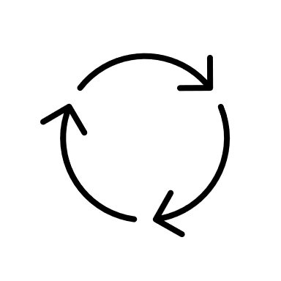
Explaining the mechanism
Virtuality ranges across teams
Team that ‘learn’ are performing well
A specific type of leadership seems to be necessary
Notes:
There are a couple of things that we learned from the interviews that we need to take into consideration for the second part of this project.
First, we noticed there is no such thing as ‘a typical virtual team’. Teams range in their virtual nature, the so-called team virtuality, and we need to consider that when trying to explain the mechanism behind highly performing engagement teams.
Second, participants considered a virtual team that ‘learns’, or where teams share information freely, and where people ‘challenge’ eachother as functioning well.
Third, Our respondents indicate that virtual teamwork requires a type of leadership that is appropriate to the setting

Slide 18
Explaining the mechanism
Empowering Leadership
Team learning behaviors
Team virtuality
Team performance
Notes:
Taking these things into consideration and utilizing previous academic literature we arrived at the following model where we take a look at the extent to which the virtual nature of a team affects the performance of the team and the role that empowering leadership and team learning behaviors play.
The left and the right in this model might be clear, however, what are those team learning behaviors, and what is empowering leadership you might wonder.

Slide 19
What are team learning behaviors?
Information sharing, constructive conflict,
co-construction
Wiese & Burke 2019
Notes:
Team learning is a whole range of actions team members can engage in to create a shared understanding of the situation the teams find itself in. and as you can see it is quite a lot, but in general we see that several of these are more impactful than others. Those three behaviors are the sharing of information, the extent to which you engage in constructive conflict, the challenging of each other's perspectives we spoke about earlier, and the extent to which we create new insights together. These behaviors have been identified as an important predictor of team performance.

Slide 20
What are team learning behaviors?
What is empowering leadership?
The engagement leader …
used the team’s ideas and suggestions.
taught team members to solve problems on their own.
told my team when we performed well.
provided help to team members.
leader cared about team members’ personal problems.
showed interest for team members’ wellbeing.
explained the purpose of the firm’s policies to the team.
explained rules and expectations to the team.
explained his or her actions to the team.
set high standards for performance by his or her own behavior.
encouraged team members to express ideas or suggestions.
worked as hard as he or she could.
set a good example by the way he or she behaved.
stayed in touch with the team.
Information sharing, constructive conflict,
co-construction
Wiese & Burke 2019
Srivastava et al. 2006
Notes:
Empowering leadership is another set of behaviors of leaders that revolve around the sharing of responsibilities and empowering fellow team members to deal with this responsibility. Here we see the scale that we used so that you get a good feel for what these behaviors involve. Empowering leadership is considered an appropriate way of leading in a virtual team as these behaviors boost teams' ability to overcome challenges related to the reduced visibility of their leaders due to the remote dimension of the team.

Slide 21
Explaining the mechanism
Empowering leadership
Team learning behaviors
Team virtuality
Team performance
Notes:
Taking that into consideration let’s go back to our model again and after our analysis, we found that this model looks slightly different than expected.-> Morph into the next slide.

Slide 22
Explaining the mechanism
Empowering leadership
0.60***
Team learning behaviors
1.33***
Team virtuality
Team performance
-1.03*
R² = 0.73
Notes:
So what we saw is that there is a significant negative direct effect of team virtuality on team performance but that empowering leadership and team learning behaviors are incredibly powerful at overcoming the challenges related to the virtual nature of a team and can tremendously boost the performance of

Slide 23
Explaining the mechanism
The virtual nature of a team matters
Highlights the role of team learning
Empowering leadership is effective
Notes:
The degree to which a team is considered virtual matters, as we see that high virtuality is associated with lower team performance.
Team learning can be a tool to overcome the challenges of virtual teamwork and engaging in empowering leadership is an important factor at stimulating team learning

Slide 24
Conclusion
What should we take away, and what is next?
Notes:
Now you know the why, the what and the how of this FAR project, let’s talk about those individual parts of the project and let’s start with the interviews.
As mentioned before it wat the intention of getting an rich understanding of how virtual teamwork is experienced in the auditing profession, and we used these interviews not only to enhance our understanding of virtual teamwork but also as a starting point for our surveys lateron.

Slide 25
Getting virtuality right
Not all circumstances are the same
The trade-offs are complex
Finding the right mix for the right moment
Notes:
Determining the right team virtuality is difficult
- Not all teams and settings are the same
- The tradeoffs are complex
- Finding the right mix of virtual teamwork is important
Conclusie: Praat er over

Slide 26
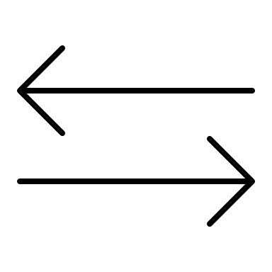
Virtual teamwork and the quality of the audit
Differences between perceptions
Underestimation of the realities of others
Focus on the process of generating quality
Develop a structured approach
Notes:
The perception of the impact is not in line with the experience of the impact
- Can potentially lead to underestimating the impact that virtual teamwork has on the performance
- Given how different hierarchical layers perceive virtual teamwork certain work arrangements might dominate others.
Heb aandacht voor het process -> Leidt wat wij doen tot kwaliteit.
Bewuste en gestrucutureerde houvast geven voor het matchen van de manier van werken aan de de context te matchen.

Slide 27
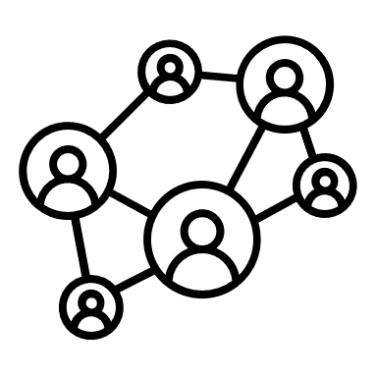
The ‘team’ in virtual team
The team is where solutions reside
Learning and empowerment are powerful resources
What leaders say and do matters
Leadership is a responsibility shared with the team
Notes:
The ‘team’ in virtual team matters, as the team is where the problems manifest, it is also where a potential solution resides.
We see that engaging in team learning boosts team performance
And that empowering leadership can be a condition that facilitates teams to engage in team learning.
En het onderstreept het belang van wat je als leider zegt en doet
Onder streept het belang van delen van leiderschap en dat Leiderschap is een verantwoordelijkheid die je deelt met het hele team.

Slide 28
What’s next?
Revisit previously
released resources
Academic
interactions
Looking forward to collaborate
Notes:
Do you want to more:
Verwijzen naar alles wat is gedaan.
What’s next academics → ISAR & Dissertation defence
Oproep voor samenwerking.
Hadden dit niet zonder jullie kunnen doen dus we willen terug geven.
And because of this we have tried to also repaid the involvement of the profession and the FAR and tried to share as much as we could so far. So today will only be a snapshot of the richness that we have in this project. If you want more information we have recorded some podcasts in the past about this research, We have written a practise note and a literature review that have been distributed through the FAR, and we have recently contributed to an issue in het Maandblad Accountancy and Bedrijfseconomie where you can find even more information about everything that I am telling today. But the research is still ongoing and we will present some more indept findings of this study at the upcoming ISAR conference and you are all cordially invited to attend my public dissertation defence probably somewhere in the first half of 2025.

Slide 29
Thank you

