Slide 1
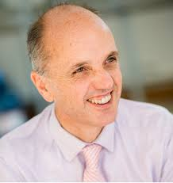
Prof. Christopher Humphrey Alliance Manchester Business School
Escaping ‘Groundhog Day’: The Transformative Possibilities of Rethinking Audit

Slide 2
Escaping Groundhog Day: The Transformative Possibilities of Rethinking Audit

Slide 3
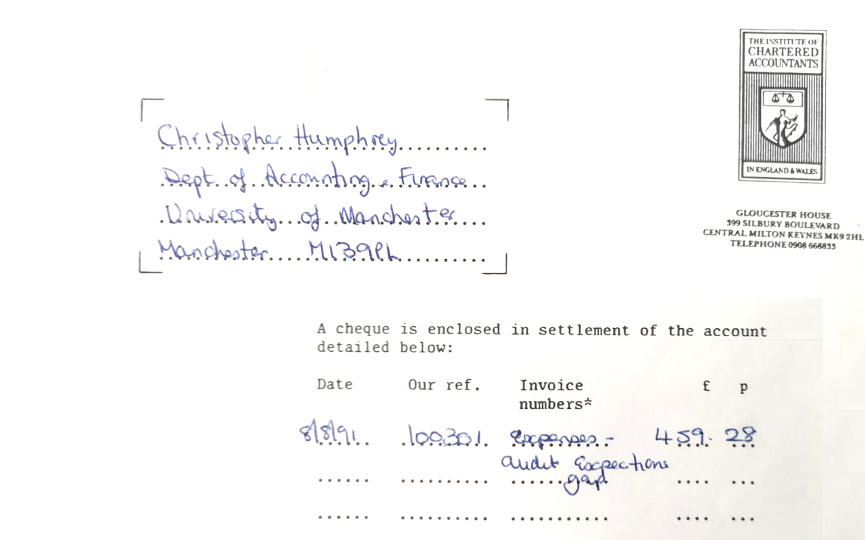

Slide 4
What has changed?
January 1991 Editorial of Accountancy magazine:
“There will be a gigantic fraud. The auditors will fail to detect it, and will be surprised when they read about it, at the same time as everybody else, in the pages of The Sunday Times. The profession will be heavily criticised. The auditing guideline on fraud will be reviewed…There will be nothing new under the sun.” (cited in Humphrey et al., 1993, p. 57, https://www.emerald.com/insight/content/doi/10.1108/09513579310027512/full/html)

Slide 5
Groundhog Day
We have now had close to two decades of independent audit regulation and inspection but we are still stressing the goal of ‘restoring trust’ in audit
Talked for so many years about building ‘public confidence in auditors and to provide a more solid foundation for the future development of the audit profession’ (McFarlane report, 1992, para. 2.5)
I saw these issues very much close-to-hand as the only academic member of the Advisory Board of the independent Brydon Review (2019) in the UK into the Quality and Effectiveness of Audit (https://assets.publishing.service.gov.uk/government/uploads/system/uploads/attachment_data/file/852960/brydon-review-final-report.pdf)

Slide 6
Extract from the Brydon Report:
“5.1.1 There is no shortage of debate and discussion of the future of audit but I found, in the words of Professor Chris Humphrey, a member of the Review’s Advisory Board, that the debate so far “encourages a form of analysis where incremental change is probably the most likely recommendation and outcome, where old ‘hobby horses’ (such as the expectations gaps or the value of IFRS and the case for prudence) frequently get resurrected, where people seek to dominate a collective discussion with their singular perspectives, and quite quickly we end up in a discussion that we seemed to have had many times over; a debate which is notable only for its familiarity and circularity – and, if any radicalism does emerge, it tends to come in the form of speculative proposals that antagonise rather than resolve, and which, ironically, reinforce or ground analysis in what we have come to accept and understand as audit (with a frequent refrain to proposed extensions in the audit being dismissed as ‘not audit’).” (Brydon report, 2019, emphasis added)

Slide 7
Stimulating something new
Focus more conceptually on what audit can become rather than what is not audit
Better than calling for the AEG to be ignored because of its longevity and persistence
We need a normative transformation in audit research – it’s 60 plus years since Mautz and Sharaf’s text on the Philosophy of Auditing!
There is a big difference between talking of the “future of audit” and the ‘future of THE audit’” (i.e., one particular conception of audit)

Slide 8
The Brydon Report was a very philosophical report on audit and audit professionalism
The critical significance of Brydon’s more expansive definition of the purpose of audit:
5.1.2 I consider that the concept of audit needs to be rethought and redefined. This redefinition needs to be rooted in a widely accepted clarification of its purpose
5.1.4 “The purpose of an audit is to help establish and maintain deserved confidence in a company, in its directors and in the information for which they have responsibility to report, including the financial statements.”
(For more discussion, see Humphrey, 2020; 2021 - https://auditfutures.net/articles/reading-the-brydon-report; https://www.icaew.com/insights/viewpoints-on-the-news/2021/jan-2021/the-brydon-report-and-the-critical-significance-of-its-conceptualisation-of-audit)

Slide 9
Conceptually - a real opportunity for the profession:
“In my opinion, Sir Donald Brydon has done the audit profession a tremendous service by highlighting a broad path forward for reforms to the audit profession (and, by implication, audit education). An historical obsession with rules and regulations has not allowed the profession to avoid audit scandals and failures. Whatever is done in the wake of the Brydon Report is unlikely to be perfect on its own. However, a significant rethinking of the nature, structure and practices of auditing may help the profession improve where stringent rules-making has lagged.”
(Knechel, W. R. (2022), Who stands for audit? A commentary on the ‘Brydon Report’, International Journal of Auditing, 26, pp. 27-31, emphasis added, https://onlinelibrary.wiley.com/doi/abs/10.1111/ijau.12265)

Slide 10
But no legislated reform in the UK (4.5 years after the Brydon report was published)
The UK government preferred that Brydon’s overall purpose of audit was treated as the overall objective of its programme of (corporate governance) reforms and for the regulator to regard it as a non-binding purpose statement for its own activities (para. 6.1.19)
There was also resistance from the profession – that it was too ambitious, expansive and not suitably specified
“6.1.8.. that it could lead to a perception that audit is forward-looking, and provides confidence in an entity’s continued viability.
https://assets.publishing.service.gov.uk/government/uploads/system/uploads/attachment_data/file/1079594/restoring-trust-in-audit-and-corporate-governance-govt-response.pdf

Slide 11
The continuing importance of thinking differently about audit
Post-Brydon, I have continued to stress the importance of reviewing the underlying premise and foundation of audit.
Building the case for a ‘dynamic’ rather than a ‘static’ repair of audit (see Humphrey et al., 2021 - https://www.tandfonline.com/doi/full/10.1080/09638180.2021.1919539).
A case which is growing (see Knechel, 2022; Adams et al., 2024 - https://www.sciencedirect.com/science/article/abs/pii/S0361368223000491).
Commitments to ‘holistic’ reform must go beyond ‘hole fixing’ and must not be oriented around changing everything but audit.
If audit/accounting firms are committed in their straplines/branding to building a better working world, formulating a new equation, or promoting ‘Omnia’ (‘being ready for everything’), this invites a major reconceptualization of audit.

Slide 12
Reconceptualizing audit –
Key recommendations

Slide 13
BE CONCEPTUALLY AMBITIOUS
Do not presume purpose; recognise the arbitrariness of existing boundaries and/or what shapes them
Focus less on restoration more on reconfiguration (e.g., compare audit functionality to that of a mobile phone)
Start from the premise that audit could be ‘everything’ (‘ready for everything’) than stressing that audit isn’t something or a burden that needs reducing
But remember that we are not auditing ‘everything’ – just what matters (so no infinite regress of audit)

Slide 14
AUDITING IS NOT STANDARD
Make the primary auditing standard one that says ‘auditing is not a standard service’
View individual audits as having their own, distinctive ‘DNA’ (acknowledge that audit can work in different ways ‘to build and maintain deserved confidence’).
Avoid the term ‘an audit is an audit’
In terms of the audit ‘market’, encourage competition on concept and product; even innovating through collaboration (attracting new entrants)

Slide 15
TREAT AUDIT AS A PRIMARY FUNCTION
See audit as a primary not a secondary activity (on whom audit’s usefulness depends)
Treat assurance as a subset of audit rather than the other way round
View audit as helping to ensure something happens than assuring something already stated; as a more direct mechanism for ‘building back better’
Take a broader conception of how auditors should view the notion and reach of ‘fairness’ (can accounts be true and fair if the underlying business model of the audited company is exploitative?)
Think of auditing as helping to establish ‘better’ truths; of drawing valued connections that demonstrate that the confidence we place in businesses/organisations is deserved

Slide 16
BOLSTER AUDIT PROFESSIONALISM
A reconfiguration of audit can drive a renewed sense and significance of audit professionalism (and vice versa)
Just what has happened to audit professionalism? UK government’s 2022 ‘audit reform’ white paper made 572 references to the ‘regulator’ but 0 references to ‘professionalism’
Is the regulator becoming the profession?
Ask how auditors can best serve the public interest rather than assuming what they already do is the best (especially given a persistent AEG); Contemplating possibilities and alternatives is an obligation once you commit to serving the public interest
Make audit a desired professional career to transfer into rather than one to resign from

Slide 17
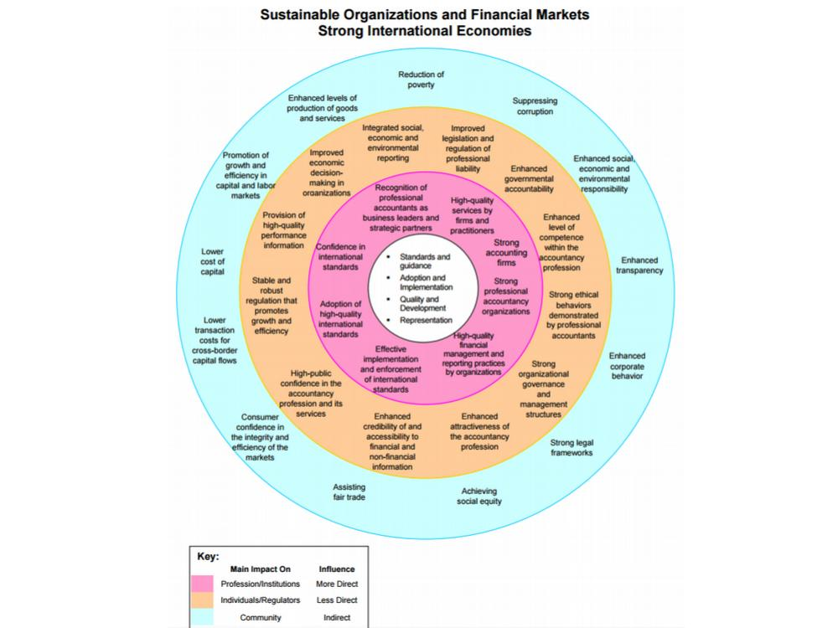
Determine how best to address societal goals, rather than assuming that what you do now is the best
Search ‘in the public interest’ for ‘better truths’, ‘better businesses’ and a ‘fairer’ society

Slide 18
VIEW AUDIT AS HAVING ITS OWN ECOSYSTEM
Treat audit as having its own eco-system rather than audit being a subset of another (financial reporting) ecosystem
An ecosystem that encapsulates different forms of audit for differing circumstances and context fits very well with the notion of an ‘auditing profession’
An audit eco-system would require more than just a set of relationships built around one specified form and set of possibilities for audit

Slide 20
REGARD THE AUDITOR AS AN ECOSYSTEM ENGINEER
We can extend the notion of audit ecosystem, in which the purpose and associated institutions of audit are incorporated in a framework connected directly to primary social and economic purposes, to talk of it being an innovation ecosystem and the auditor regarded as an ecosystems engineer
Which brings us back to groundhog day…..

Slide 21
REGARD THE AUDITOR AS AN ECOSYSTEM ENGINEER
A ‘groundhog’ is a land beaver – and beavers are categorised as ‘ecosystem engineers’, used as natural flood prevention devices; helping to create new natural ecosystems; nurturing life
Potential to see the ‘audit society’ more positively. Audit also becomes ‘mortal’ and more ‘dynamic’ - the more it impacts, the less we need a certain form of audit?
Indeed, if audit causes us to revise our expectations, then this could be the expectations ‘gap’ that serves to justify audit – audit makes us think/feel/act differently?

Slide 22
FROM THINKING DIFFERENTLY ABOUT AUDIT TO THINKING DIFFERENTLY IS AUDIT

Slide 23
THINKING DIFFERENTLY IS AUDIT
the fundamental problem confronting audit is not one of trust and confidence but one of relevance and significance of purpose
It is the compelling and informative nature of what the auditor finds/feels/says and the impact this has that matters most
Audit has to stand as a different or distinctive voice, thinking/feeling/saying things that others do not or will not – through this the audit helps to build and maintain deserved confidence…
…a sort of ‘financial conscience’ (Speech at the 50th anniversary of ICAS’ royal incorporation in 1904)

Slide 24
THINKING DIFFERENTLY IS INSPIRING - NOT BURDENSOME
Deloitte, in promoting its new audit approach (‘Omnia’ - to be ready for everything) stated: “Bring your audit into focus; We bring bright minds, a flexible methodology, and world-class audit technology together for impact beyond your expectations.”
But its first point of emphasis was on reducing the “audit burden” https://www2.deloitte.com/us/en/pages/audit/solutions/audit-technology-solutions.html
View audit as fundamentally central to accounting professionalism
And not something to be partitioned behind regulatory walls
Nor to be constrained by psychological hesitancies or intransigence

Slide 25
THINKING DIFFERENTLY IS TRANSFORMATIVE
Think audit first, accounting second…
Think electric

Slide 26
Thank you

