Slide 1
Leadership Behaviors of Partners and Managers and the Effects on Audit Teams
Prof. Dr. Olof Bik
University of Groningen

Slide 2
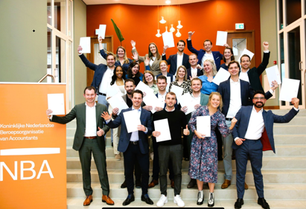
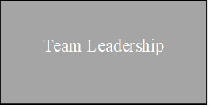
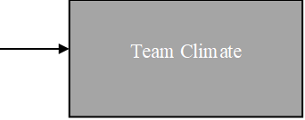
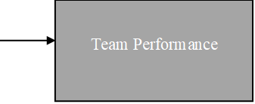
Research Question in FAR context
Adapted from Alberti, Bedard, Bik, and Vanstraelen (2022): “Audit Firm Culture: Recent Developments and Trends in the Literature”, Figure 1.

Slide 3
Research Question
Team leadership styles and behaviors matter for team dynamics and performance
Single-leader research
But… audit teams are not led by one leader…
… by TWO: the Partner and the Manager
How does Partner and Manager leadership combine and interact to affect audit team dynamics?
Partner
Manager
Engagement Team

Slide 4
Research Question
1.
Leadership styles that teams need to function well: Task and Team focused.
2.
Leadership behaviors that teams follow: “Good” versus “Bad” leadership-by-example.
?
Which matter most from which source?
How do the Partner’s and Manager’s leadership styles and behaviors best “match”?

Slide 5
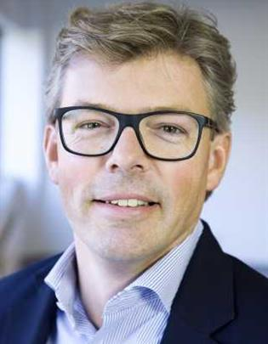
We needed six team leaders…?
Prof. Murray Barrick
Texas A&M
Prof. Olof Bik
University of Groningen
Prof. Jere Francis
Maastricht University & FAR Audit Research Chair
Prof. Bradley Kirkman
North Carolina State University
Lena Pieper
University of Illinois at Urbana-Champaign
Prof. Ann Vanstraelen
Maastricht University
The authors thank all participants and data providing audit firms and thank the Foundation for Auditing Research (FAR) for their support in data collection and their grant 2019E01.
UNIQUE RESEARCH
COLLABORATION
Notes:
Introduce the project overall

Slide 6
Data gathering
Two surveys with ten participating audit firms in the Netherlands (the Big 4 and six-medium sized firms) + internal firm data
“Leader-Survey”: engagement team members assess the Partner and the Manager on a particular engagement (2,336 responses for 661 unique leaders for 381 engagements)
“Team-Survey”: engagement team members assess the team climate (1,287 responses for 380 engagements)
1/3 of all signing partners were selected
Two engagements per partner
Two surveys send to all core team members
Final Sample of up to 127 complete matched audit engagement teams (e.g., at least 3 observer ratings of leaders & follower ratings of team climate, internal firm data available).

Slide 7
Results and Findings (RQ1)*
1.
Leadership styles that teams need to function well: Task and Team focused.
What are the effects of dual Partner AND Manager leadership styles of “Initiating Structure” (Task) and “Individualized Consideration” (Team)…
…on “Team Efficacy” (Climate)…
…and, ultimately, on “Team Performance” and “Team Viability”?
* Barrick, M.R., Bik, O.P.G., Francis, J.R., Kirkman, B.L., Pieper, L., and Vanstraelen, A. (2023) It Takes Two to Make a Team Go Right: The Impact of Dual Team Leader Consideration and Initiating Structure Behaviors on Team Efficacy, Performance, and Viability. Working paper.

Slide 8
Initiating Structure & Consideration
Two key leader styles that all teams need are (Stogdill, 1974; Judge et al., 2004; Burke et al., 2006):
Initiating Structure (Task Work): describes how a leader assigns group member roles and channels of communication, initiates action, defines how tasks are to be accomplished by the team and the time-line for doing so.
This leadership style is task-oriented, getting the job done.
Individualized Consideration (Team-Work): describes the extent to which a leader exhibits concern for the welfare of team members – oriented towards interpersonal relationships: building mutual trust & team confidence.
This leadership style is people-oriented.

Slide 9
Team Efficacy
Team Efficacy: a team’s shared perception of its capacity to successfully perform its tasks which emerges from team member interactions.
Particularly relevant for (fluid and episodic) audit teams: need to maintain ongoing and immediate collective confidence to perform.
Team Performance: team quantity and quality of productivity (current team effectiveness).
Team Viability: the capacity of a team to continue working together over time (future team effectiveness).

Slide 10
SINGLE LEADER model would look like this:
Team Performance
Partner Consideration
& Initiation Structure
Team Efficacy
Team Viability

Slide 11
But a DUAL LEADER structure looks like this:
Team Performance
Partner Consideration
& Initiation Structure
Team Efficacy
Manager Consideration & Initiating Structure
Team Viability

Slide 12
Discussion of results (RQ1)
Conventional Wisdom: Partner leads Task, Manager leads Team oriented.
Our evidence suggests its more complicated.
Better when the Partner is higher on both Task and Team orientation style.
“Super Partners” (fully engaged, not only on the task).

Slide 13
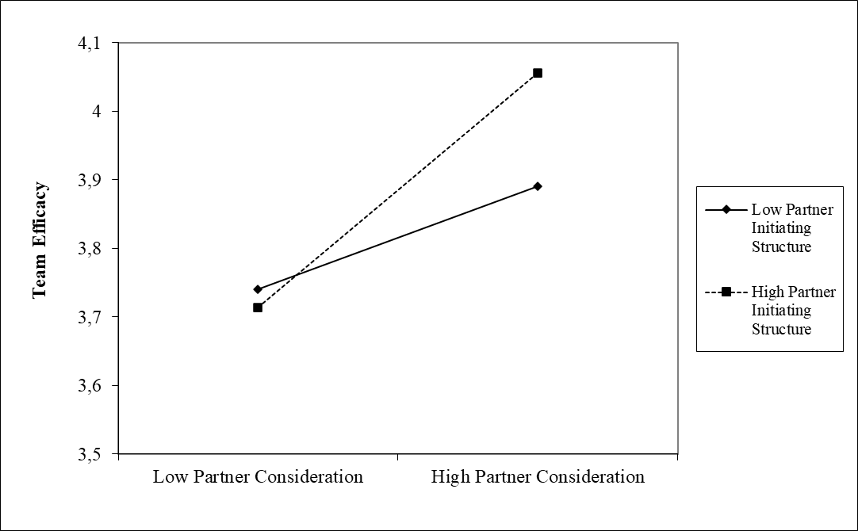
“Super Partners” in dual leader structure
2
1

Slide 14
Discussion of results (RQ1)
Conventional Wisdom: Partner leads Task, Manager leads Team oriented.
Our evidence suggests its more complicated.
Better when the Partner is higher on both Task and Team orientation style.
“Super Partners” (fully engaged, not only on the task).
Better when the Partner and Manager both are high on Team orientation.
“Power of Consideration”.
Task is still important but best comes from the Partner.

Slide 15
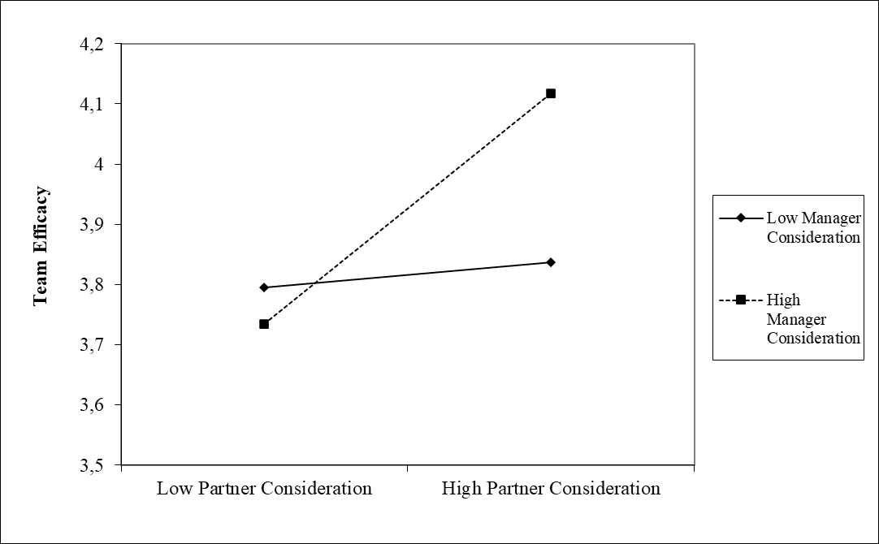
“Power of Consideration”
2
1

Slide 16
Contribution to audit quality (RQ1)
1
Both the Partner’s AND the Manager’s leadership styles really matters; both Task and Team, but in different ways
2
Task oriented leadership might be less important.
Audits are a well-defined (structured) process
3
Team oriented leadership might be more important
Audit work is episodic: teams convene, adjourn, reconvene over phases.
Audit teams are fluid: team changed during and the next year.
Team oriented leadership style fosters sense of “team-ness”.

Slide 17
Results and Findings (RQ2)*
2.
Leadership behaviors that teams follow: “Good” versus “Bad” leadership-by-example.
How can Partners and Managers jointly “lead-by-example” to improve audit team psychological safety, voice climate, and performance?
“Good” → Voice Role-modeling behavior.
“Bad” → “Cheating” (cutting corners, fake sign-offs, etc.).
* Barrick, M.R., Bik, O.P.G., Francis, J.R., Pieper, L., and Vanstraelen, A. (2023) Audit Team Leaders as Role-Models for Voice Behavior: Moderating Influences of Mixed Behavioral Messages on Team Psychological Safety, Voice Climate, and Effectiveness. Working paper.

Slide 18
Voice Modeling Behavior
Prerequisite to Voice: Team members need to feel psychologically safe
Team Member Voice = speaking up voluntarily
Team Performance
but it is interpersonally risky to do so
Leading-by-example (“voice contagion”) : Team Members are more likely to speak up themselves (“copy”) when Team Leaders portray the advantages of voice behavior, supporting feedback and expressing constructive ideas, and encouraging members to willingly speak up.
Notes:
Team psychological safety: the belief that the team is perceived as relatively safe and secure for interpersonal risk taking, thereby enabling followers to speak up (Edmondson, 1999).
Voice Modeling Behavior: One key function skilled leaders depend on is setting an example, since followers are expected to observe their leaders and copy what they do (Adair, 1973; McGrath, 1962).
Team members observe and emulate those modelled leader behaviors (Loon, Lim, Lee, & Tam, 2012; Ng, Lucianetti, Hsu, Yim, & Sorensen, 2021).
Are members more likely to feel psychological safety when observing leader’s voice modeling behaviors?

Slide 19
Results underscore the dominant influence of the day-to-day Manager when considering employee voice and perceived safety, over that of the Partner.
(+) b =.38**
n/s

Slide 20
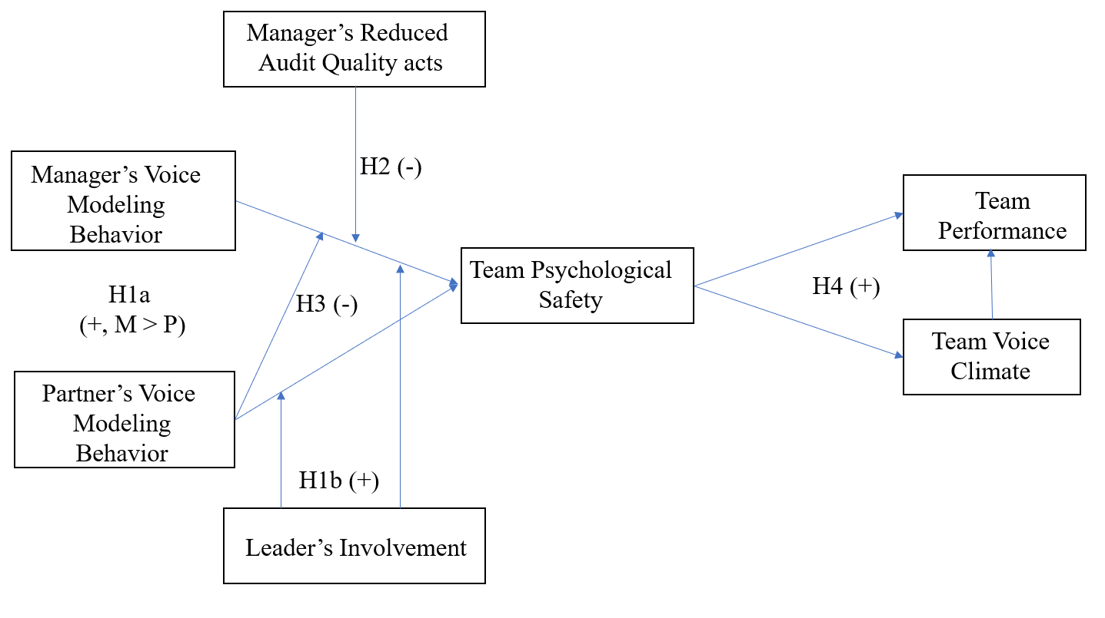
Manager Involvement: the positive association between voice modeling behavior is strengthened when the manager spends more time with the team (b = .15*)

Slide 21
“Cheating”: when the team observes the manager cuts corners in the audit, it essentially nullifies the positive influence of voice modeling behavior (b = -0.24**)

Slide 22
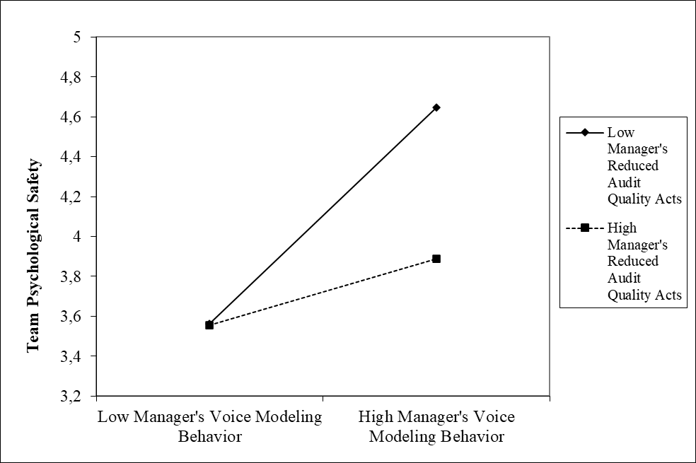
“Cheating” nullifies all “good” role modeling
1
2

Slide 23
Contribution to audit quality (RQ2)
How can audit Partners and Managers jointly “lead-by-example” to improve audit team psychological safety, voice climate, and performance??
1
The manager’s “good” role-modeling behavior has a stronger influence than that of the Partner’s – and this is even stronger with more involvement.
2
Prevent “mixed messaging”: cheating is toxic for psychological safety and voice climate.
3
The Manager is the “climate engineer” of an audit team.

Slide 24
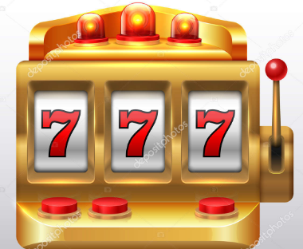
Sum: Partner and Manager Leadership Matters
Leadership… | … style |  | … by example
 | Task | Team | Voice | “Cheating”
Audit Partner
Audit Manager
Do firms really “take a gamble” when it comes to their Partner-Manager matching on teams?
Well… they do seem to leave it to chance: 68% of Partners are given the freedom to choose their manager – and when given a choice, will self-select a “similar other”.*
* Barrick, M.R., Bik, O.P.G., Francis, J.R., Pieper, L., and Vanstraelen, A. (2023) Audit Partner-Manager Dyadic Fit and Team Functioning. Working paper.

Slide 25
Contribution to audit quality (in Sum)
Contribution to the academic literature:
Our study is among first to study the role of joint leadership styles and role modeling behavior of the audit Partner & Manager in building the “right” team climate.
Provides new insights on team climate of audit teams by using data from actual teams.
Contribution to audit practice:
Our studies provide the firms with insights on how Partner & Manager leadership influences team climate. The findings could be used when making team composition decisions.
Tone-at-the-Top is actually “Tone-in-the-Middle” (too): manager is the “climate-engineer”.
Audit firms routinely grant Partners freedom to select their own Manager (68% of cases) and the audit firms should understand possible consequences of that choice while people have a natural tendency to associate with people who are similar to themselves.

Slide 26
Some next steps
Implicit assumption: Team climate is associated with audit outcome quality.
We plan to test this using audit outcome measures (e.g., financial reporting quality proxies, audit effort, realization rate).
Leadership style “flexibility”: Do Partner and Manager adapt their style depending on team needs?
Leadership “received”: Do team members differentiate their audit behavior in response to differences in “leader-member-exchange”?

Slide 27
Q&A – thank you!

Slide 28
Thank you

