Slide 1
Tjibbe Bosman University of Amsterdam
Audit Office Culture and Audit Quality

Slide 2
Introduction
10y at PwC in the Netherlands and Germany, involved at FAR
PhD-candidate University of Amsterdam (June 26) / Incoming Tenure-Track Vrije Universiteit Amsterdam (September ‘24) Supervisors: Jan Bouwens and Olof Bik, papers: - Audit Office Culture and Audit Quality - Skin in the Game: Consequences of Audit Partner Clawback Adoption - Do Assigned Audit Partners Perform More Effective and Efficient Audits Than Self-Selected Auditors? Work-in-Progress: - Does Auditing Prevent Fraud? Evidence from Bankruptcies - Who Benefits from Mandatory Audit Requirements? - The Determinants and Consequences of Disciplinary Auditor Convictions in the Netherlands
We welcome all suggestions and input on the paper and the data

Slide 3
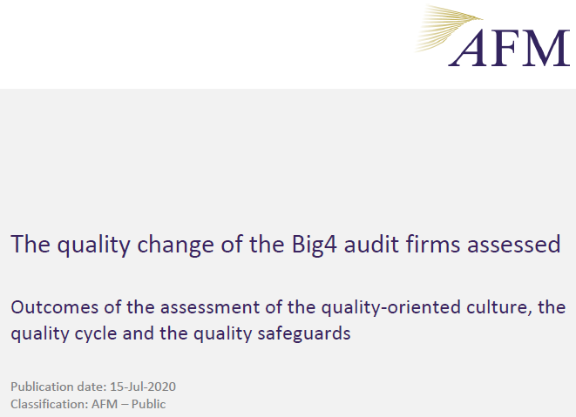
Audit Firm Culture
Recognized by IAASB 2014, PCAOB 2023, FRC 2018 and AFM 2020
Auditors face important ambiguities in their daily work, while the quality of their work is largely unobservable.
Audit firm culture might be an effective social control mechanism to deal with these ambiguities (O’Reilly, 1989)

Slide 4
Why Culture?
Audits are idiosyncratic and require judgment (ambiguity in standards)
Residual risk from the audit risk model is never zero (AR = IR x CR x DR)
Audit quality is hard to observe in the short-term (credence good)
Individual auditors invest in and depend on their (professional) relations with their colleagues (partnership).
Subpar performance may have significant reputational effects on colleagues’ - perceptions are relevant
With observability out of reach, social norms might be an effective control

Slide 5
What Culture?
Organizational culture is defined as “a pattern of shared assumptions, beliefs, and expectations that guide members’ interpretations and actions by defining appropriate behavior within an organization” (Chatman, Caldwell, O’Reilly, and Doerr 2014, 787)
Operationalized by the aggregated perceptions of auditors of
Error Climate – Gronewold and Donle (2011)
Voice – Van Dyne and LePine (1998)
Quality Leadership – Self-developed with the NBA
Pressures – Beekes et al (2014)

Slide 6
Why is dealing with errors hard?
Errors are in direct conflict with Audit Quality (Seckler et al 2017, 24)
There is always an element of surprise to errors (Bell and Kozlowski 2011) and people are inclined to consider errors as signals of negative performance or lack of intelligence (Mangels, Butterfield, Lamb, Good, and Dweck 2006).
To admit to a mistake, individuals expose their weaknesses to the organization, which imposes on interpersonal relation and their career perspective (Emby, Zhao, and Sieweke 2019).
Sign of a lack of accountability, poor ability, knowledge and/or performance (Grohnert et al. 2019, 218) / Fear of sanctions (Westermann et al 2019, Gold et al 2021)
Up-or-out / grow-or-go complicates the handling of errors (Jones et al. 2010)
Due care obligation <-> “no blame culture” (Walton 2004)

Slide 7
Why is dealing with errors important?
Organizational culture develops from how organizations deal with errors (Frese and Keith 2015)
Error climate informs group members on the expected behavior within a working group on how to deal with and learn from errors (Cannon and Edmondson 2001). Socialization to avoid structural errors (Westermann et al. 2015)
Auditors report to learn most from informal learning such as learning on-the-job (Daoust and Malsch 2019) and learning from errors is more likely than learning from success (Joung et al. 2006; Dahlin et al. 2018).

Slide 8
Positive Error Climate Effects
Audit staff is more willing to discuss errors made by peers, as well as their own (Gold et al. 2013)
Feel more responsible for errors (Gronewold and Donle 2011)
Junior auditors are more likely to seek help from a superior (Grohnert et al. 2019)
Self-report errors (Stefaniak and Robertson 2010; Gronewold et al. 2013)
Mitigate learning barriers (Van Mourik et al. 2021)

Slide 9
Voice
Partners are dependent on a team for the performance of an audit
Partners exhibit significant overconfidence in the ability of subordinates to detect errors (Messier et al. 2008)
Tacit knowledge is important in auditing (Bol et al. 2018)
Prior survey and experimental auditing studies use auditors’ willingness to speak up as a dependent variable
Risk of too much irrelevant input (Morrison 2004) and the difussion of responsibilities
Voice has a negative relationship with decision-making accuracy (LePine and Van Dyne 2001)
Speaking-up is not sufficient to avoid failures (Noort et al. 2021)
Inverted U-shape with performance in the restaurant industry (MacKenzie et al. 2011)

Slide 10
Quality Leadership
Firm performance is associated with perceiving top managers as trustworthy and ethical (Guiso, Sapienza, and Zingales 2015)
Leadership influences subordinates' tolerance for ambiguity (Pratt and Jiambalvo 1982)
Leadership style affects the willingness of auditors to engage in dysfunctional behavior (Otley and Pierce 1995, 1996)
Audit firms value leadership ability (Dong, Kallunki, Nilsson, and Vanstraelen 2021)
TATT deficiencies as recognized by interviews during PCAOB inspections are associated with lower audit quality (Aobdia 2020).
Mid-level auditors seem more important than leadership roles (Aobdia et al 2022)
Partners in leadership roles are not “…necessarily the partners with the greatest technical expertise” (Mowchan et al. 2021, 11).
Leadership roles distract partners from their responsibilities as a signing auditor, leading to a reduction in audit quality (Mowchan, Seidel, and Zimmerman 2021).

Slide 11
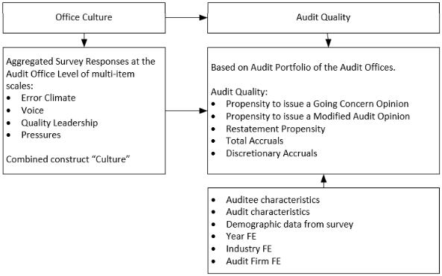

Slide 12
Data Gathering & Analysis
Collaboration with the NBA and five international PIE audit firms
1,137 survey respondents in the audit line of service, average response rate of 67,8%
Referent shift consensus model (daily work environment: audit office)
37 audit offices with at least 10 responses (average 30 respondents per office)
Identified 89.6% of audits performed by these offices

Slide 13
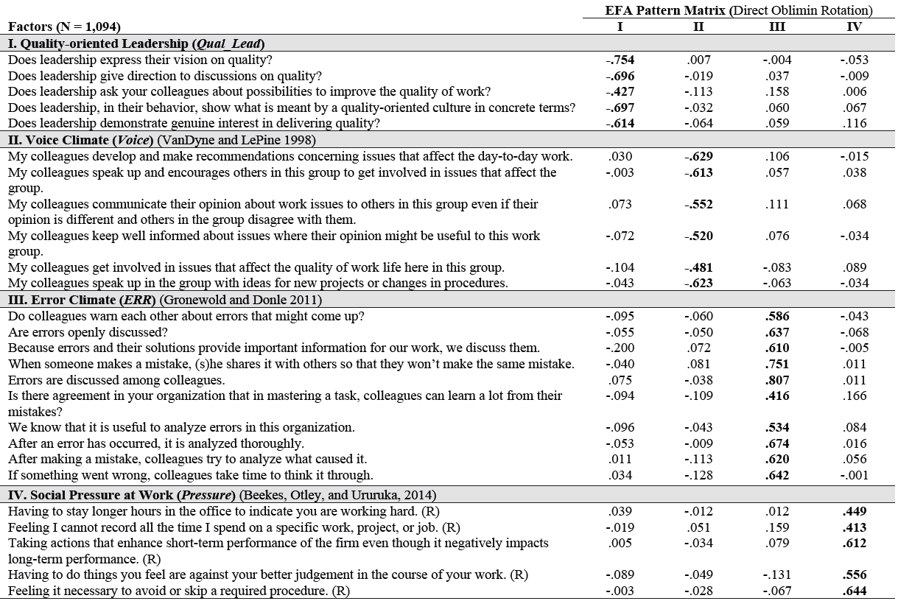

Slide 14
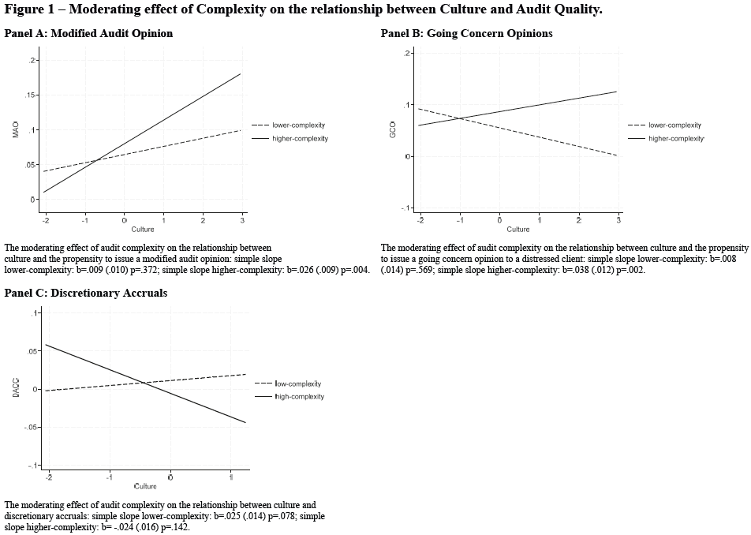

Slide 15
Conclusion
Audit firm culture measured by the aggregated perceptions of auditors of Error Climate, Voice, Quality Leadership and Pressures differs significantly between firms and between individual office locations.
Office culture dimensions positively relate to variance in audit quality, measured by the propensity to issue a modified or going concern audit opinion and help to explain quality differences between offices.
Findings suggest that audit firm culture is an effective social control mechanism for delivering high-quality audits.
That the relation between culture and audit quality is more pronounced in more complex audit settings, where auditors face increased ambiguity and uncertainty.

Slide 16
Thank you

