Slide 1


Eddy Cardinaels
Tilburg University
Evelien Reusen
Rotterdam School of Management
Silence is Not Golden: How do Team Consensus and Inclusive Climate Affect Junior Auditor’s Conformity Behavior and Assessment Sharing?

Slide 2





Contents
Research Question
Theory & Hypotheses
Data Collection
Analyses & Results
Conclusions

Slide 3

Research Question
In hierarchically structured audit teams, it is common practice that junior auditors gather most of the evidence used as the basis for the audit opinion, which makes information sharing critical.
Audit standards state that:
auditors should be on ‘high alert’ for information or other conditions that signal a material misstatement due to fraud may have occurred
auditors should incorporate and share all relevant information in conducting quality audits
Yet, it has been noted that auditors may not always do so:
individual auditors may be hesitant to raise potentially important audit issues (Clor-Proell et al. 2022, 2023; Gissel and Johnstone 2017; Griffith et al. 2020; Nelson et al. 2016)
individual auditors may even discard their private information, including fraud-relevant information, in an audit engagement when the majority viewpoint, i.e., the team’s consensus, suggests that the likelihood of fraud on a client is low
Audit engagements where individual auditors have important fraud-relevant information, but the team’s consensus is that the likelihood of fraud is low, are particularly at risk of non-detection.
How does learning about team consensus influence junior auditors’ reliance on their private information in forming their assessment and willingness to share this with others?

Slide 4


Research Question
  RQ:
  What happens if a junior auditor uncovers red flags indicative of fraud, thus high risk, yet team consensus suggests that the risk of fraud is low? Will they conform to the majority’s view?
  RQ 1: Will this be determined by the origin of the team consensus, stemming from more senior members vs. junior members?
  RQ 2: Can this be mitigated by installing a particular inclusive climate, emphasizing authenticity vs. belongingness?

Slide 5

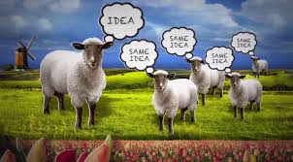
Theory & Hypotheses
Theory of conformity:
Junior auditor

Slide 6
Theory & Hypotheses
Theory of conformity:
~ Herd mentality / Groupthink
  Occurs in groups when individual thinking or critical reflection is lost or subverted to stay within the consensus of the group view.
  When groups ‘go along to get along,’ the end result of the decision-making process is likely to be less effective than if group members question the information at hand, being careful to look at the problem from a variety of perspectives.
  In auditing context:
    Individual auditors suppress their own views, to conform with the majority (consensus) view (e.g. Beasley and Jenkins 2003; Kleinman and Palmon 2009)
    A high-skeptic team member can persuasively influence a majority of low-skeptic team members, resulting in higher skepticism as a team (McAllister et al. 2021)
      However, this requires the minority member(s) with a different opinion not to conform to the majority view and to speak up !

Slide 7
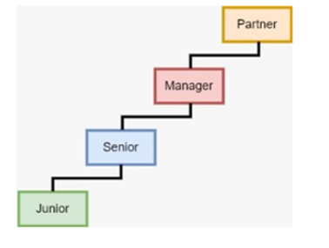
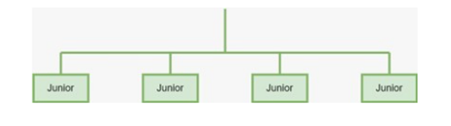
Theory & Hypotheses
The impact of origin of team consensus:
  Senior members: higher task-relevant knowledge; more experience, expertise, status, and influence (e.g., Clor-Proell et al. 2023; Gissel and Johnstone 2017; Harding and Trotman 2017; Peecher 1996)
    Reputation risk of having a different view and sharing it (Blum et al. 2022; Brazel et al. 2016)
    Supervisor negative reactions to challenging the ‘status quo’ (Nelson et al. 2016; Nelson and Proell 2018)

Slide 8
Theory & Hypotheses
The impact of origin of team consensus:
  H1: Junior auditors who learn about the low-risk consensus view of more senior team members, relative to junior team members, are more likely to conform to this view, resulting in a lower final risk assessment.
  Effect of origin of team consensus on final fraud risk assessment is mediated by conformity

Slide 9
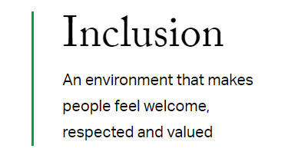

Theory & Hypotheses
The impact of inclusive climate:
Many organizations seek to prioritize DEI initiatives to foster an organizational culture where every voice is welcomed, respected and heard.
https://www.gallup.com/workplace/215939/diversity-inclusion.aspx

Slide 10
Theory & Hypotheses
The impact of inclusive climate:
defined as “the degree to which individuals experience treatment from the group that satisfies their need for belongingness and uniqueness” (Shore et al. 2016)
consisting of two dimensions: “belongingness” and “authenticity” (Jansen et al. 2014)

Slide 11
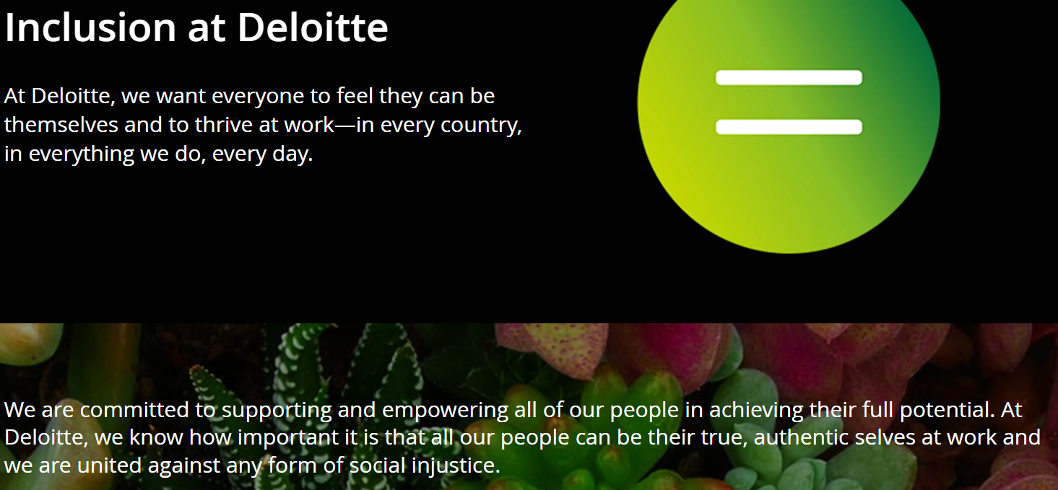
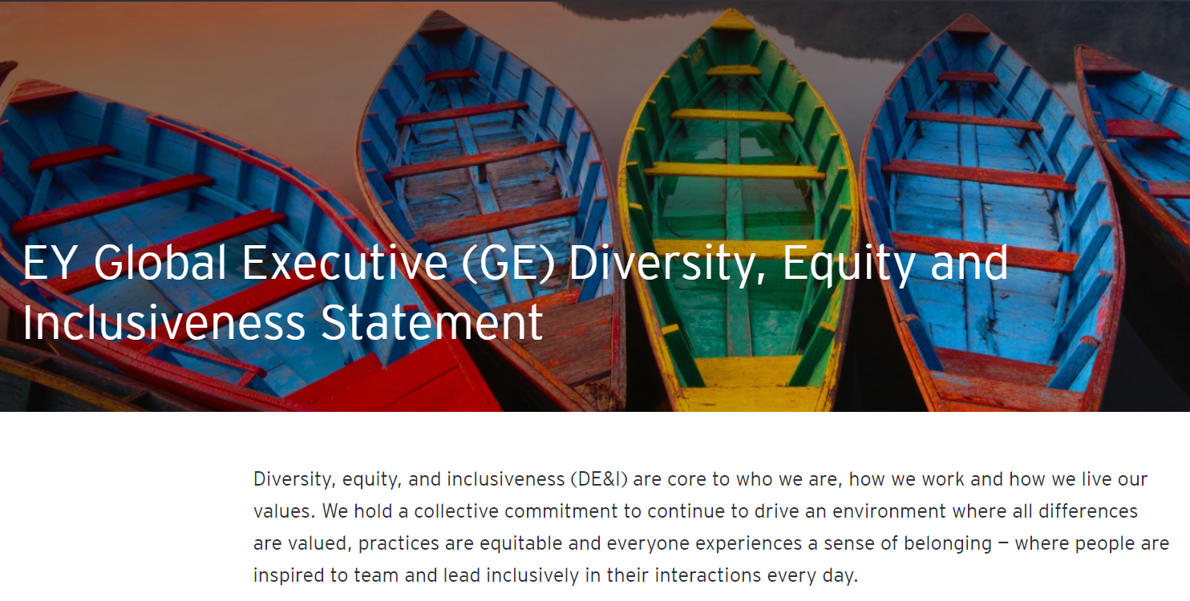
Theory & Hypotheses
Theory & Hypotheses

Slide 12
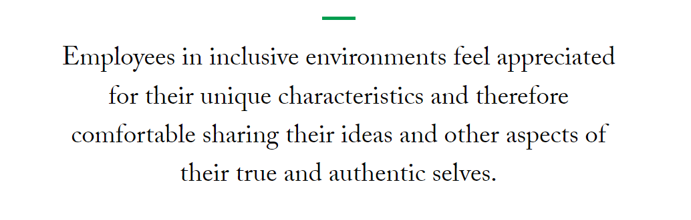
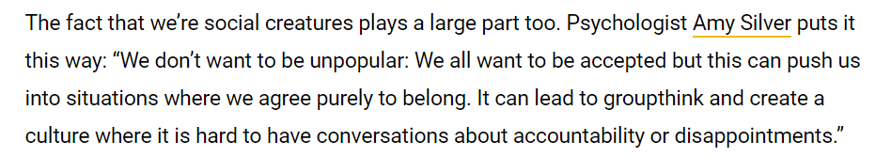
Source: Gallup, 3 Requirements for a Diverse and Inclusive Culture, 2018
Inclusion*
Source: https://www.inhersight.com/blog/diversity/groupthink
Authenticity
Belongingness
Inclusive climate: need to be authentic
Show self-concepts (e.g., traits, opinions) and remain true to oneself
Individuals’ unique characteristics are appreciated and seen as valuable and required for group success (Shore et al., 2011)
Inclusive climate: need to belong
Form and maintain strong and stable relationships
Individuals treated as an insider when they conform to the dominant norms of the culture (Shore, et al., 2011)
Prior literature: reduce conformity behavior
Prior literature: increase conformity behavior
* Jansen, Otten, Van Der Zee, and Jans (2014); Shore, Randel, Chung, Dean, Ehrhart, Singh (2011)

Slide 13
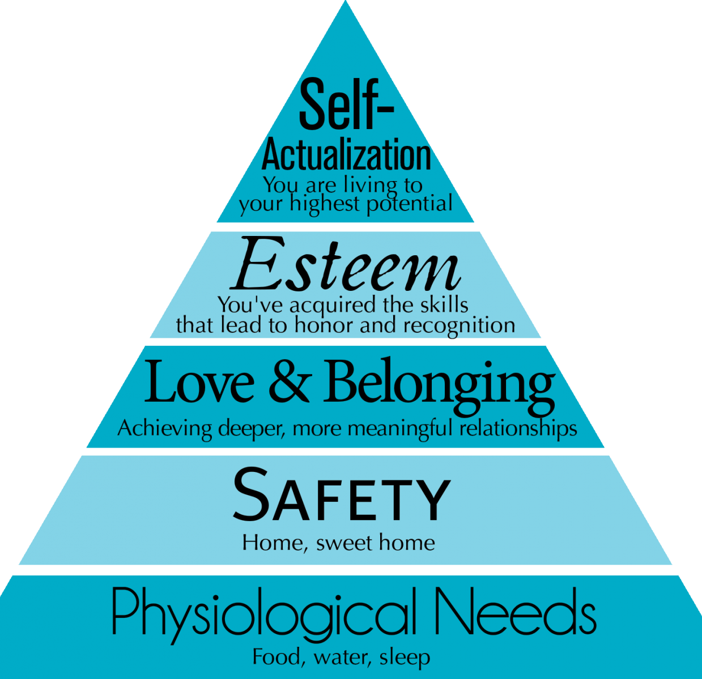
Theory & Hypotheses
Auditors’ tendency to conform may also be driven by their deficit needs
  individuals must first satisfy lower-level deficit needs before progressing to meet higher-level growth needs (Maslow et al.1998; see also, Griffith et al., 2022)
When authenticity is emphasized, yet need for belongingness is not fulfilled:
→ desire to fit in
→ ‘regulated’ or ‘bounded’ authenticity
→ conform to majority
When need for belongingness is fulfilled, then able to progress to self-actualization:
→ more confident in / comfortable with challenging the majority’s viewpoint
authenticity
belongingness

Slide 14
Theory & Hypotheses
The impact of inclusive climate:
H2: The tendency to conform to more senior, compared to junior team members, is stronger under an authenticity climate than under a belongingness climate, resulting in a lower final risk assessment.
  Effect of the origin of team consensus on juniors’ conformity and subsequent fraud risk assessment is moderated by inclusive climate

Slide 15
Theory & Hypotheses
Authenticity vs. Belongingness
Conformity
Inclusive climate
H2
H1
H1
Origin of Team Consensus
Final Risk Assessment
More senior members vs. All junior members

Slide 16

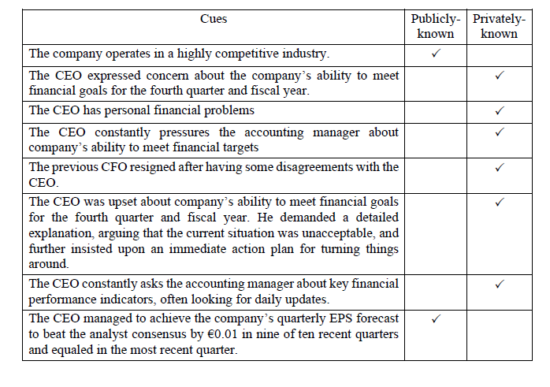
Data Collection - Experiment
Participants: 127 junior auditors (max. 36 months work exp.) at two Big 4 firms in the Netherlands
Case: Hypothetical ‘fraud’ case adapted from Gissel and Johnstone (2017), Holder-Webb and Kohlbeck (2006), and Kohlbeck et al. (2009) → Task: evaluate the client’s fraud risk
  Information of client background, summary of financial statements, industry, audit and
  management background, and situational cues
  Conformity = How do we study this?
  Team consensus suggests low fraud risk
  Private cues suggest high fraud risk

Slide 17


Data Collection - Experiment
Design: 2 x 2 between-subject experiment
Factor 1: Inclusive climate
Authenticity:
We foster a culture where everyone is encouraged to be their unique selves at work. This means that, as an auditor, you are true to your own personality, values, and spirit. It is in this atmosphere – characterized by authenticity and respect for individual differences – that we work together to fulfill all our assignments.
Belonging:
We foster a culture everyone feels connected to their colleagues at work. This means that, as an auditor, you are part of one big family with strong stable bonds among colleagues. It is in this atmosphere – characterized by a strong sense of belongingness and team spirit – that we work together to fulfill all our assignments.

Slide 18
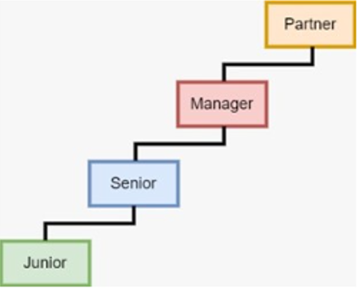
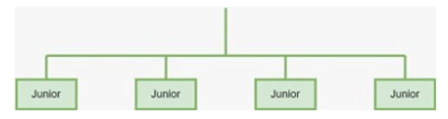
Data Collection - Experiment
Factor 2: Origin of team consensus
Seniors: Now suppose you are going to have an informal discussion with your team members, consisting of a partner, a manager, a senior auditor, and a junior auditor.
Juniors: Now suppose you are going to have an informal discussion with your team members, consisting of four junior auditors.
You have just finished reviewing and analyzing your data, right before the discussion starts. While waiting for the meeting to start, you ask your team about their analysis and judgments regarding the Company's fraud risk. They told you that nothing remarkable was found from their tasks and analysis. As a result, they uniformly indicate that they belief the likelihood of fraud at the Company to be substantially low.

Slide 19
Data Collection - Experiment
Outcome variables:
Initial Risk Assessment and Final Risk Assessment
Based on the available information, please assess fraud risk on a scale of zero to ten, where zero is “low risk” and ten is “high risk”
Conformity
Average of three items, reflecting whether: (i) their assessment was affected by the team’s assessment, (ii) they changed their assessment to be the same of the team, and (iii) they followed the team assessment. (0 = strongly disagree; 7 = strongly agree)
Willingness to Share Own Assessment
On a scale of zero to ten, how comfortable are you in sharing your own risk judgment with the team? (cf. Gissel and Johnstone 2017) (0 = not comfortable; 10 = extremely comfortable)

Slide 20


Analyses & Results
Effect of the origin of team consensus on (i) junior auditors’ conformity, and subsequently, (ii) their final risk assessment
In support for H1:
significant negative indirect effect of OriginOfTeamConsensus on FinalRiskAssessment via Conformity

Slide 21
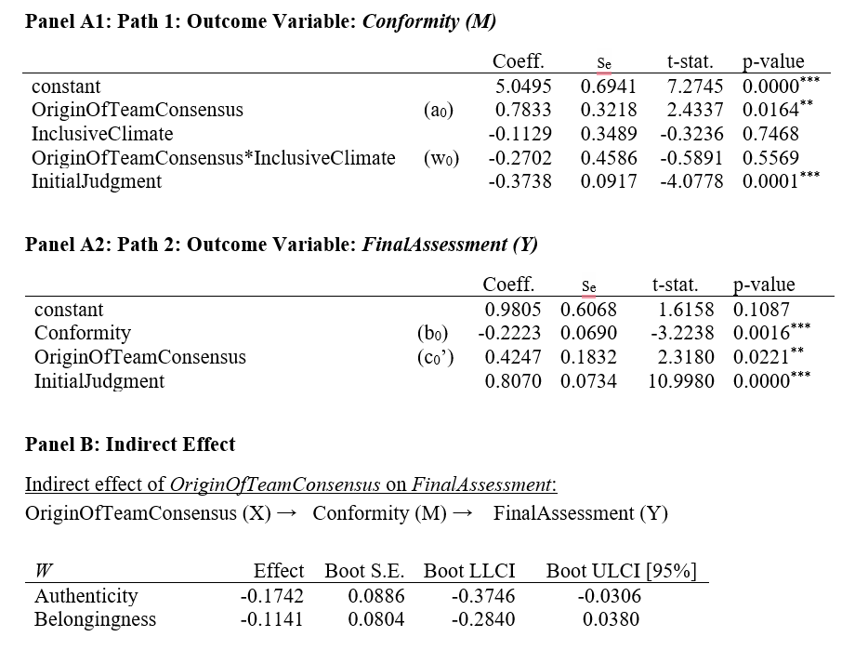
Analyses & Results
Moderating effect of inclusive climate on (i) the origin of team consensus and junior auditors’ conformity; and, subsequently, (ii) their final risk assessment
In line with H2:
significant negative indirect effect holds under authenticity climate, but not under belongingness climate

Slide 22
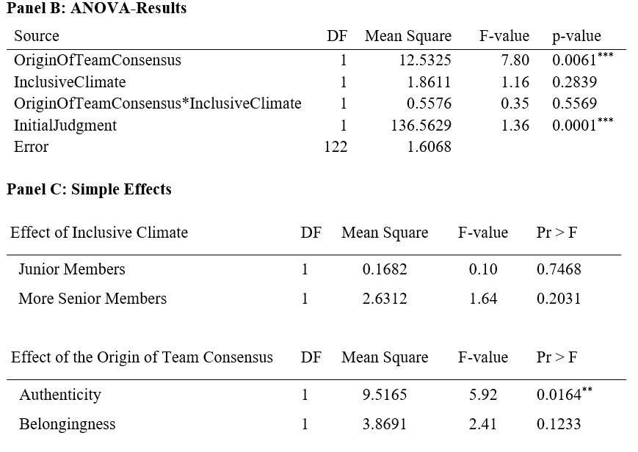
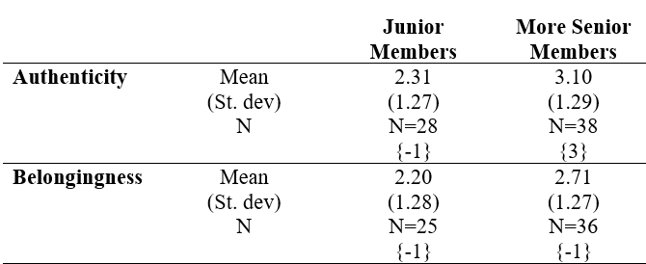
Analyses & Results
ANOVA on junior auditors’ conformity
contrast testing {-1, -1, 3, -1} is significant (F = 7.31; p < 0.01)

Slide 23
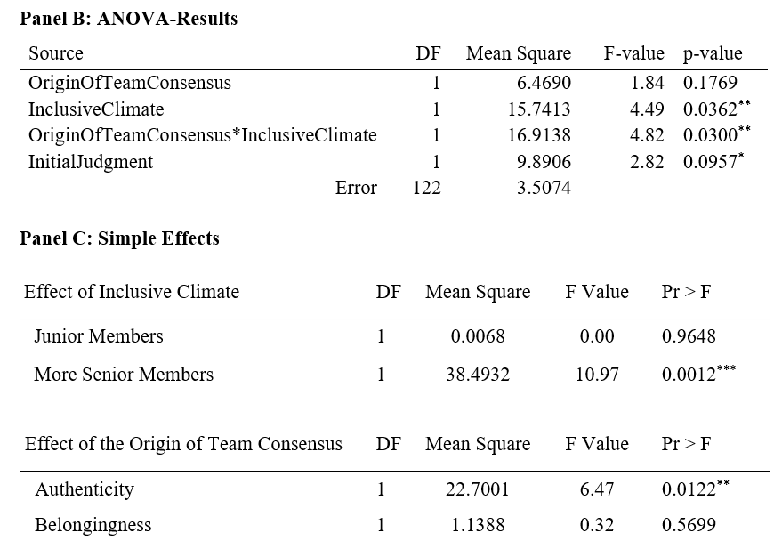
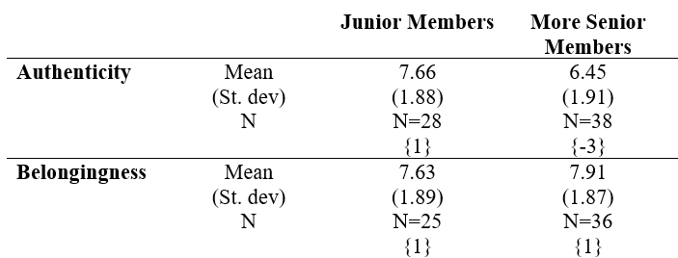
Analyses & Results
ANOVA on junior auditors’ assessment sharing
Contrast testing {1, 1, -3, 1}
is significant (F=11.74; p<0.01)

Slide 24

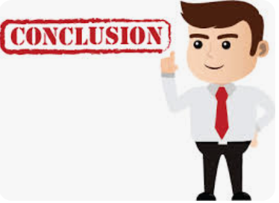
Conclusions
We find evidence of junior auditors’ conformity, and more (less)
so when the consensus viewpoint is expressed by senior (junior) members
Novel insights on the effect of inclusive climate on junior auditors’ conformity
Responding to calls for research on climate and culture, and inclusion
  Practical relevance:
  In hierarchical teams, the importance of encouraging individuals to share information is crucial (in particular when authenticity is emphasized);
  Solely encouraging juniors to show their true self may not always result in desired effects (more conformity, less info sharing)
  Audit firms can cultivate a climate of belongingness, rather than authenticity, via team-building initiatives, regular one-on-one social engagements between junior and senior members, fostering a sense of connection, support, and psychological safety

Slide 25

Thank you

